Slide 1
بسم الله الرحمن الرحيم

Slide 2
8th Meeting of Quality Enhancement Cells (Phase-III)
University of Health Sciences, Lahore
Presented By: Prof. Arif Rashid Khawaja
FRCS (Ed), FRCS (Gen Surg)
Director Quality Enhancement Cell
University of Health Sciences, Lahore

Slide 3
Agenda of 8th Meeting of Phase III QECs
Actions taken against the weaknesses identified in SARs and the status of the corrective action planned for their removal
Discussing and assigning action plans for the assessment year 2014-15
Workshop on Six Sigma in Higher Education (resource person will be arranged by HEC)

Slide 4
Team Members
Name | Posts | Status | Date of appointment
Prof. Dr. Arif Rashid Khawaja | Director | Contract | 6-Dec-2010
Dr. Allah Rakha | Deputy Director | Additional Charge | 26-Dec-2012
Waqas Latif | Data Analyst | Contract | 13-Jul-20111
Noreen Aslam | Personal Assistant | Contract | 9-Jul-2011
- | NQ | - | -
- | Additional Posts | - | -

Slide 5
Introduction:
The Quality Enhancement Cell was established on 6th, December, 2010 on the directive of the Vice Chancellor, UHS, Lahore. University of Health Sciences, has always endeavored to maintain high Quality in all the departments, both academic as well as administrative. Quality assurance is a process-driven approach with specific steps to help define and attain goals. This process considers design, development, production, and service. The goal is to ensure that excellence is inherent in every component of the process. Quality assurance also helps determine whether the steps used to provide the product or service are appropriate for the time and conditions.

Slide 6
Vision & Mission Statement
Vision
"Developing a viable and sustainable mechanism of quality assurance in higher learning at UHS to meet the rising challenges of transforming the country into a knowledge economy"
Mission
"To integrate the concept of quality assurance at UHS in higher learning with compatibility through capacity building"

Slide 7
Running Program
The following M.Phil. programs are running at UHS at postgraduate level:
Anatomy
Behavioral Sciences
Biochemistry
Chemical Pathology
Forensic Sciences
Haematology
Human Genetics & Molecular Biology
Immunology
Microbiology
Morbid Anatomy & Histopathology
Medical Laboratory Sciences
Pharmacology
Physiology & Cell Biology
Transitional Doctor of Physiotherapy (T-DPT)

Slide 8
Running Program
The following Ph.D. programs are running at UHS at postgraduate level:
Anatomy
Biochemistry
Human Genetics
Microbiology
Morbid Anatomy & Histopathology
Oral Pathology
Pharmacology
Physiology
Cellular and Molecular Biology
Forensic Sciences

Slide 9
Running Program
The following Master programs are running at UHS at postgraduate level.
Nursing
Masters in Health Professional Education (MHPE)
Masters in Family Medicine

Slide 10
Self Assessment Exercise (SAE)
The Self-Assessment Exercise has been completed of the following fifteen programs;
M. Phil Anatomy
M. Phil Behavioral Sciences
M. Phil Biochemistry
M. Phil Haematology
M. Phil Human Genetics & Molecular Biology
M. Phil Immunology
M. Phil Microbiology
M. Phil Morbid Anatomy & Histopathology
M. Phil Pharmacology
M. Phil Physiology & Cell Biology
M.Sc. Nursing
M.SC Medical Laboratory Technology
M. Phil Forensic Medicine & Toxicology
Ph.D. Forensic Sciences
Transitional Doctor of Physiotherapy (T-DPT)

Slide 11
Self Assessment Exercise (SAE): In process
The following programs are in process:
Masters in Health Professional Education (MHPE)
Masters in Family Medicine
M. Phil Chemical Pathology
M. Phil MLS

Slide 12
Corrective Actions Taken and Current Status in View of Implementation Plans of Fifteen Programs

Slide 13
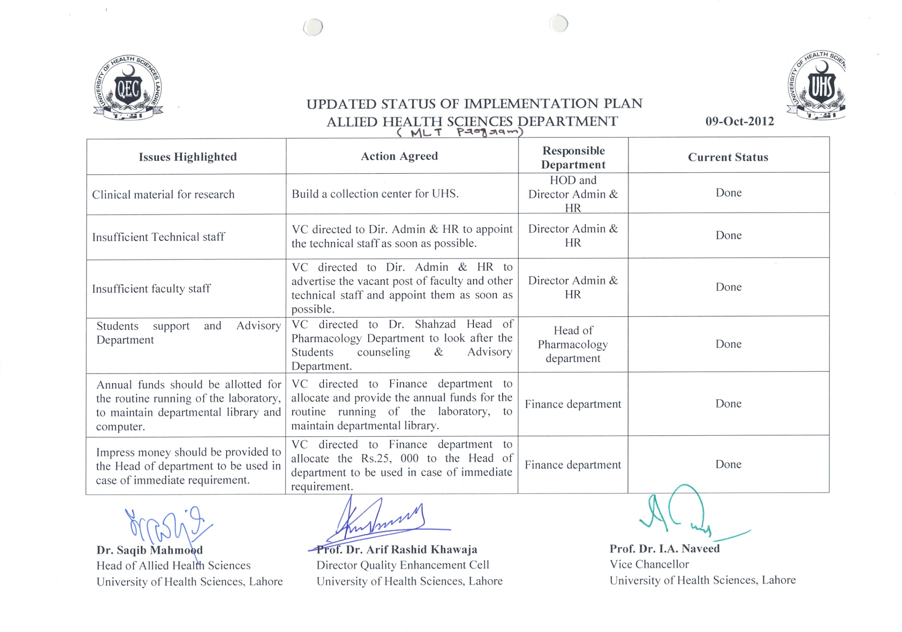
M.Sc. MLT

Slide 14
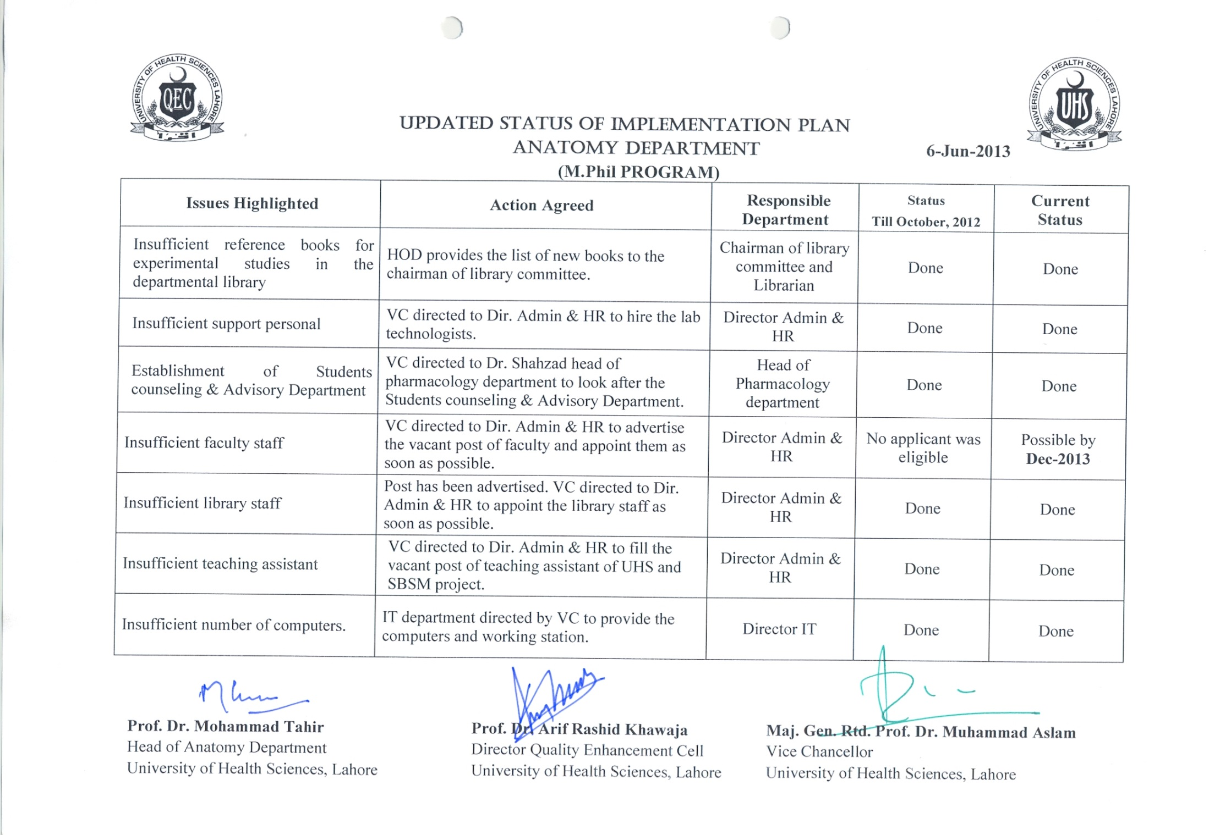
M. Phil Anatomy

Slide 15
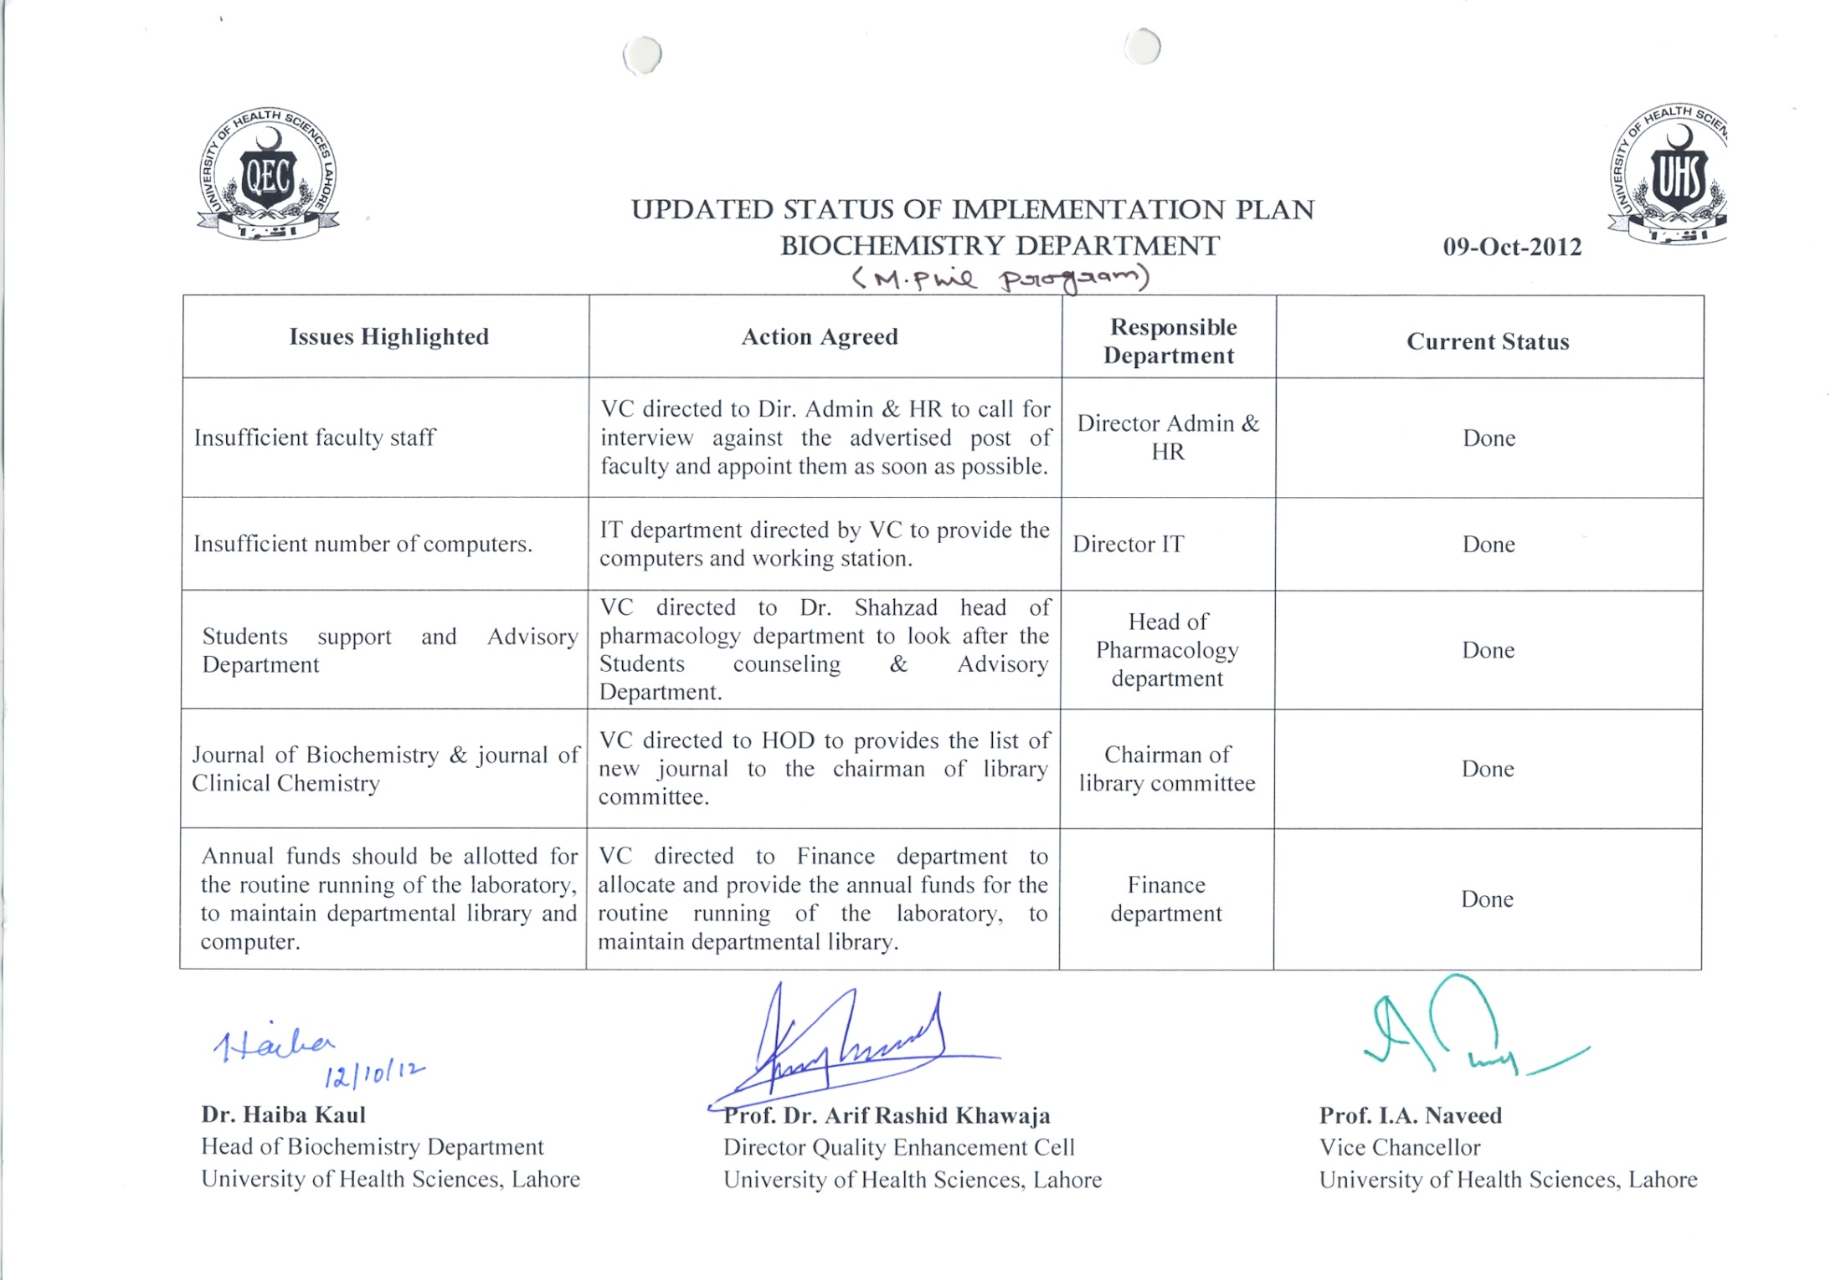
M. Phil Biochemistry

Slide 16
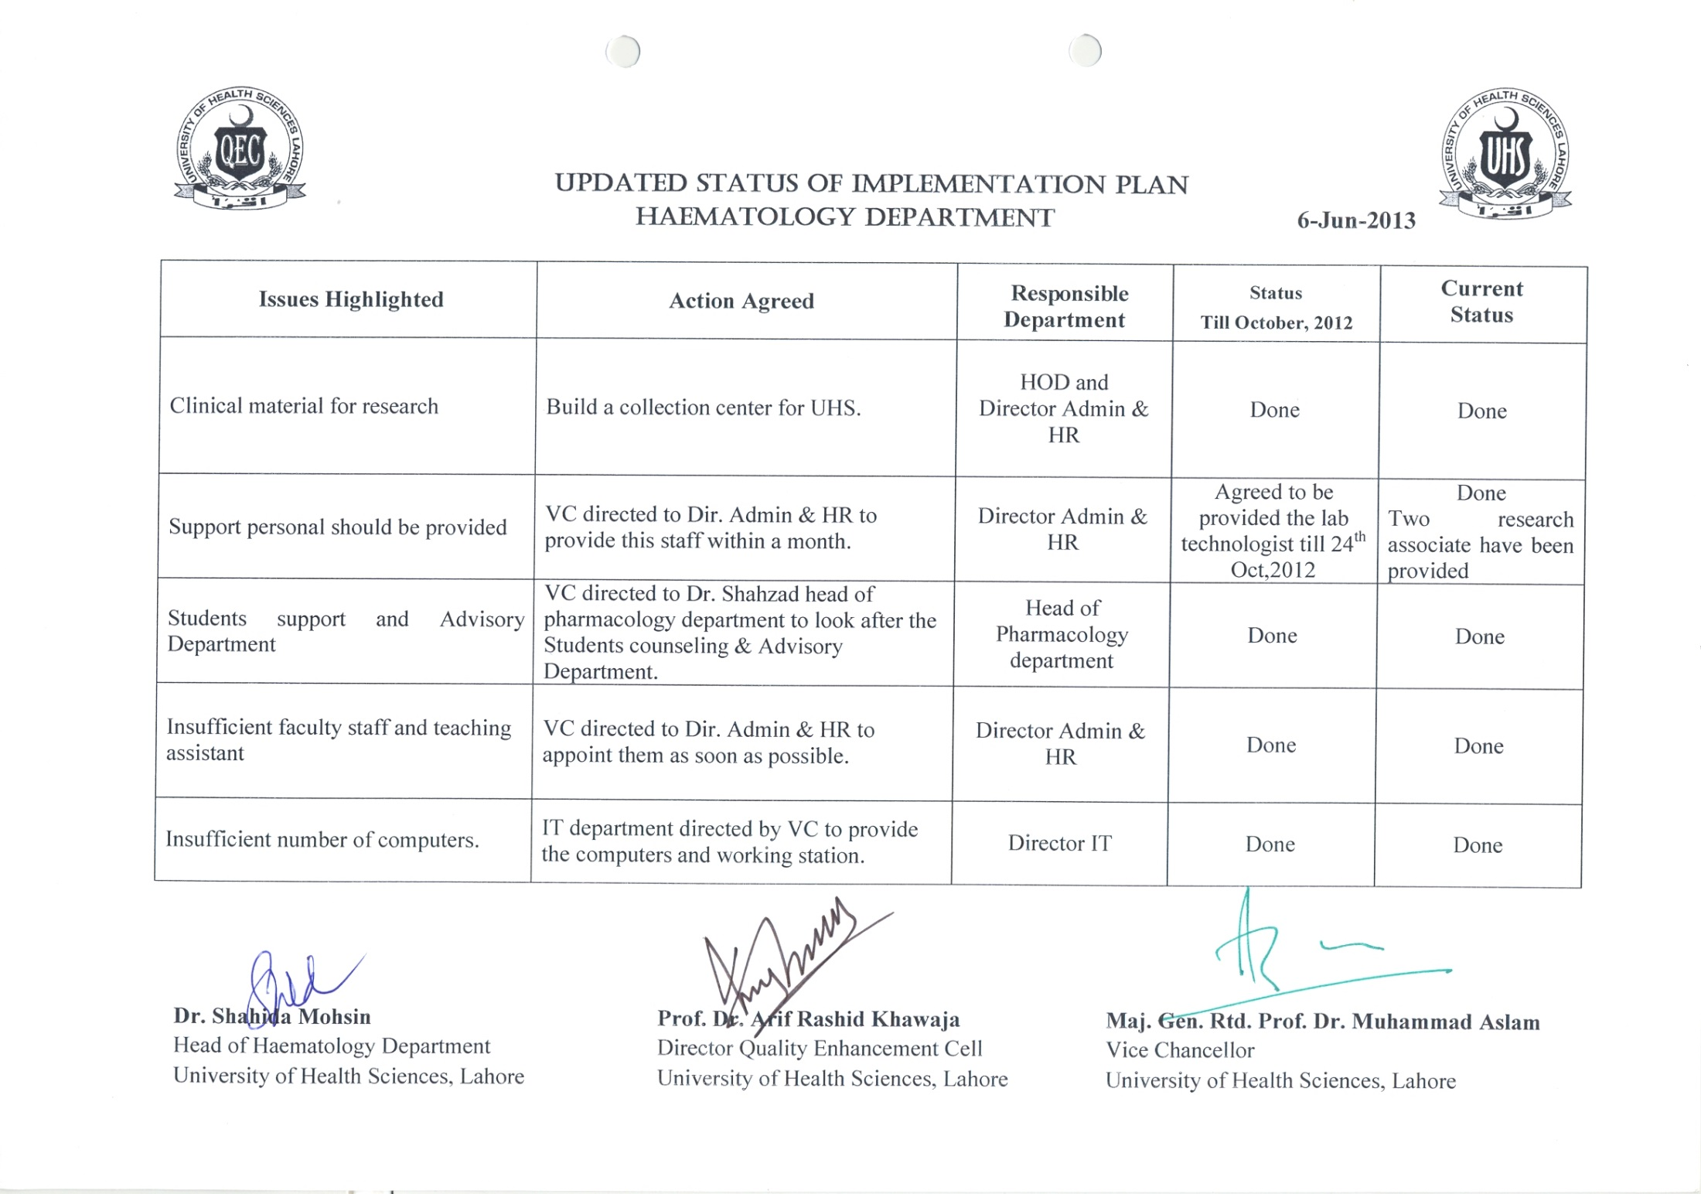
M. Phil Haematology

Slide 17
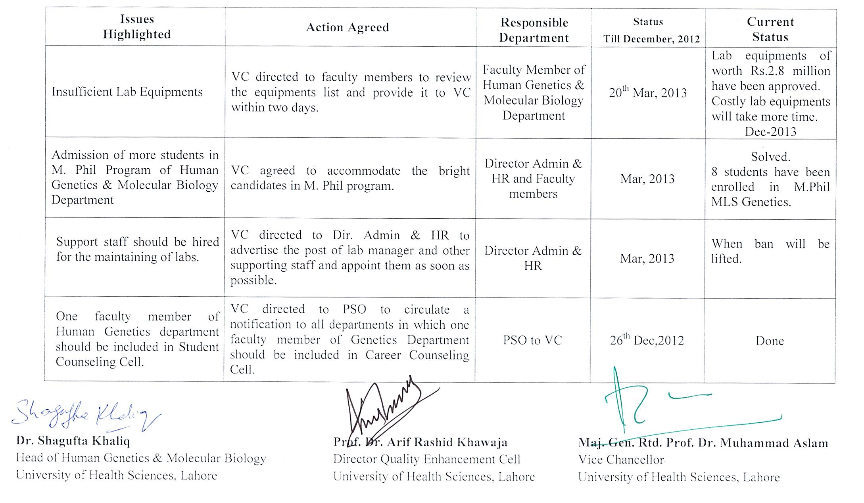
M. Phil Human Genetics & Molecular Biology

Slide 18
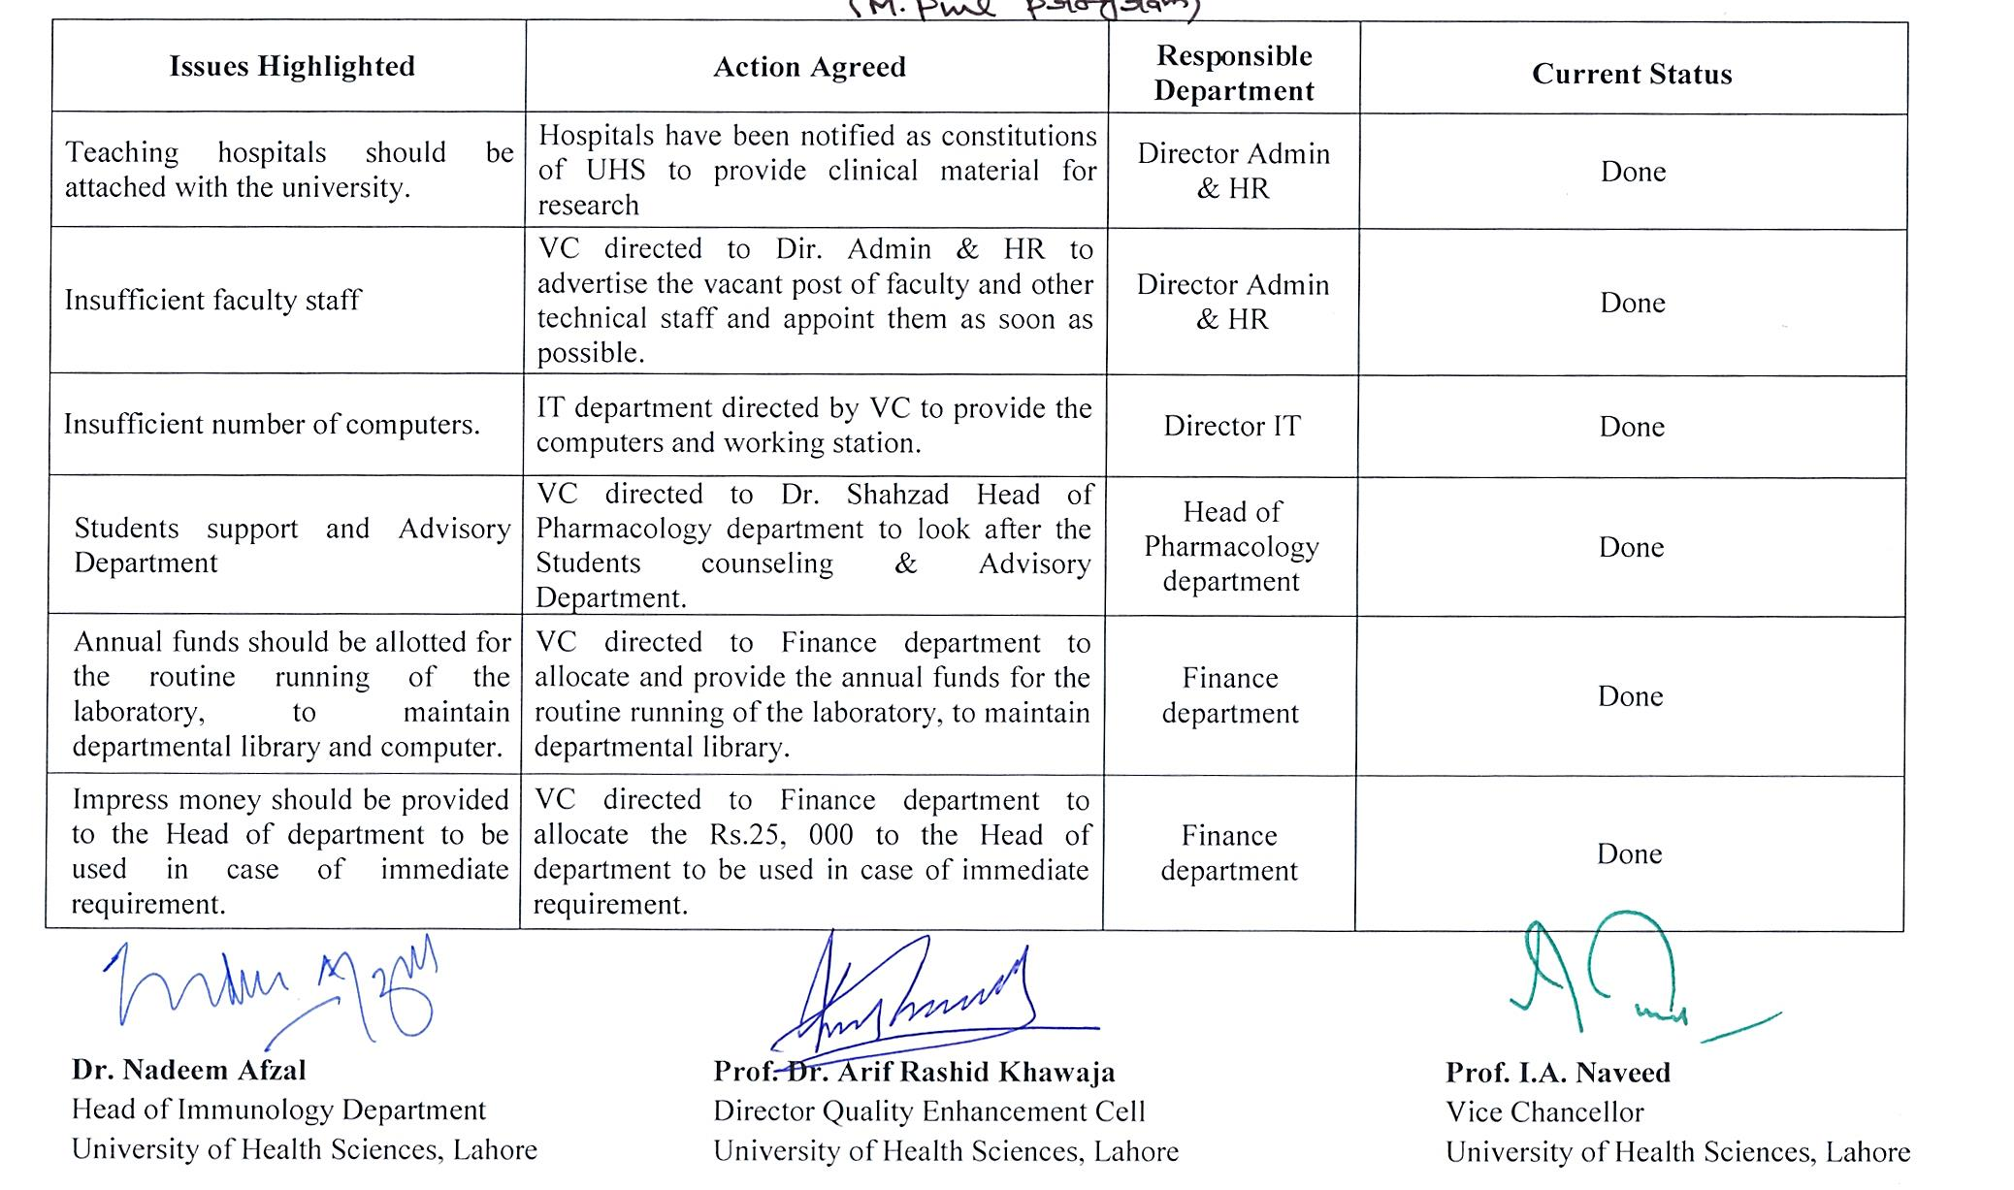
M. Phil Immunology

Slide 19
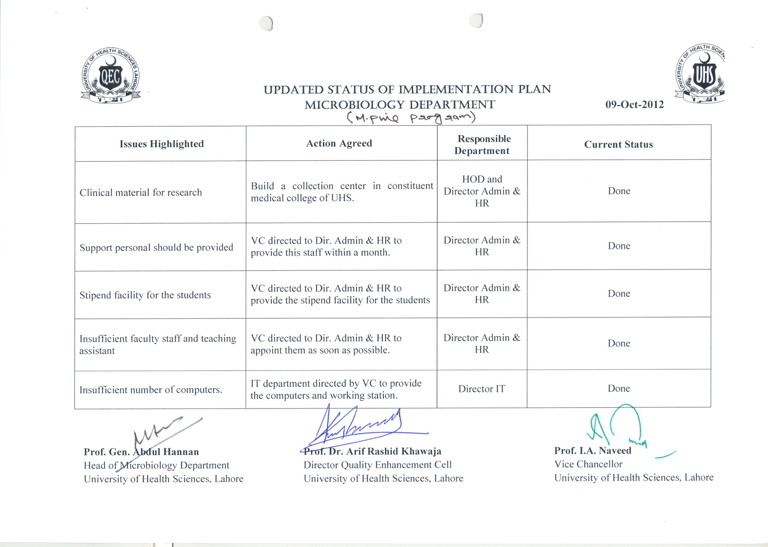
M. Phil Microbiology

Slide 20
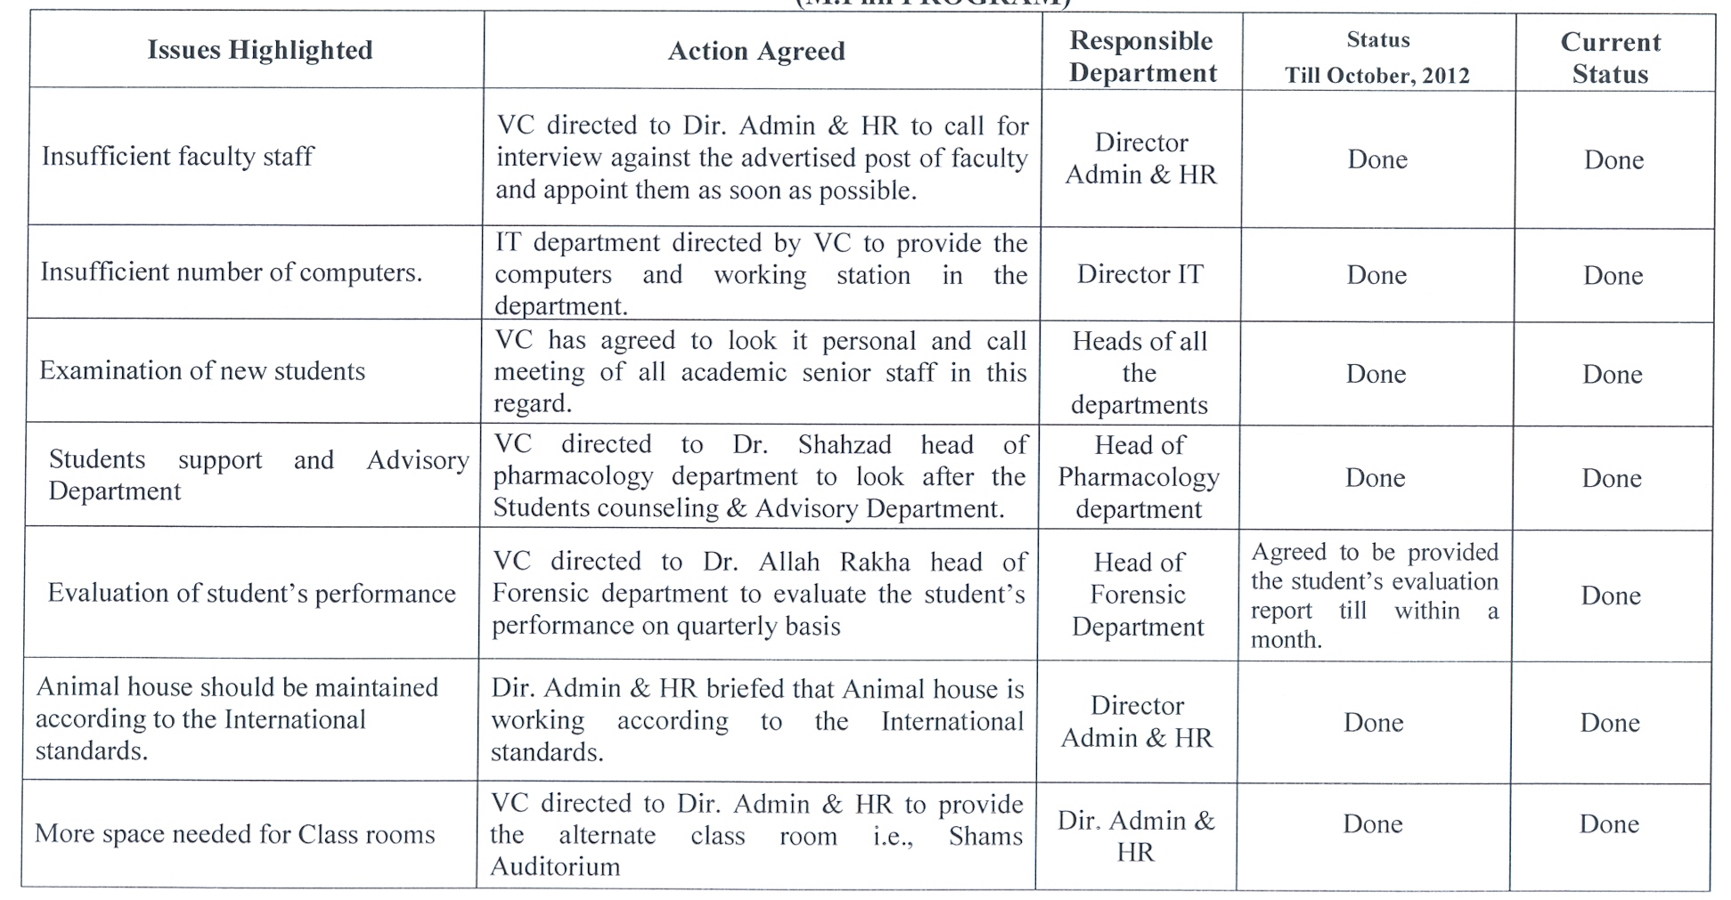
M. Phil Morbid Anatomy & Histopathology

Slide 21
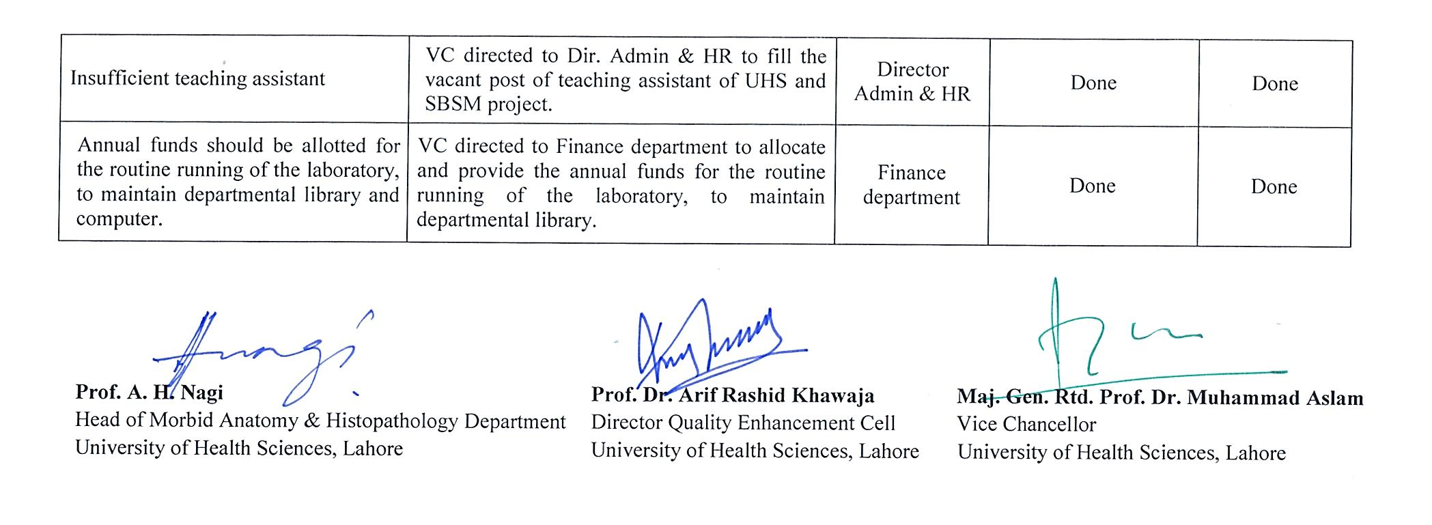
M. Phil Morbid Anatomy & Histopathology

Slide 22
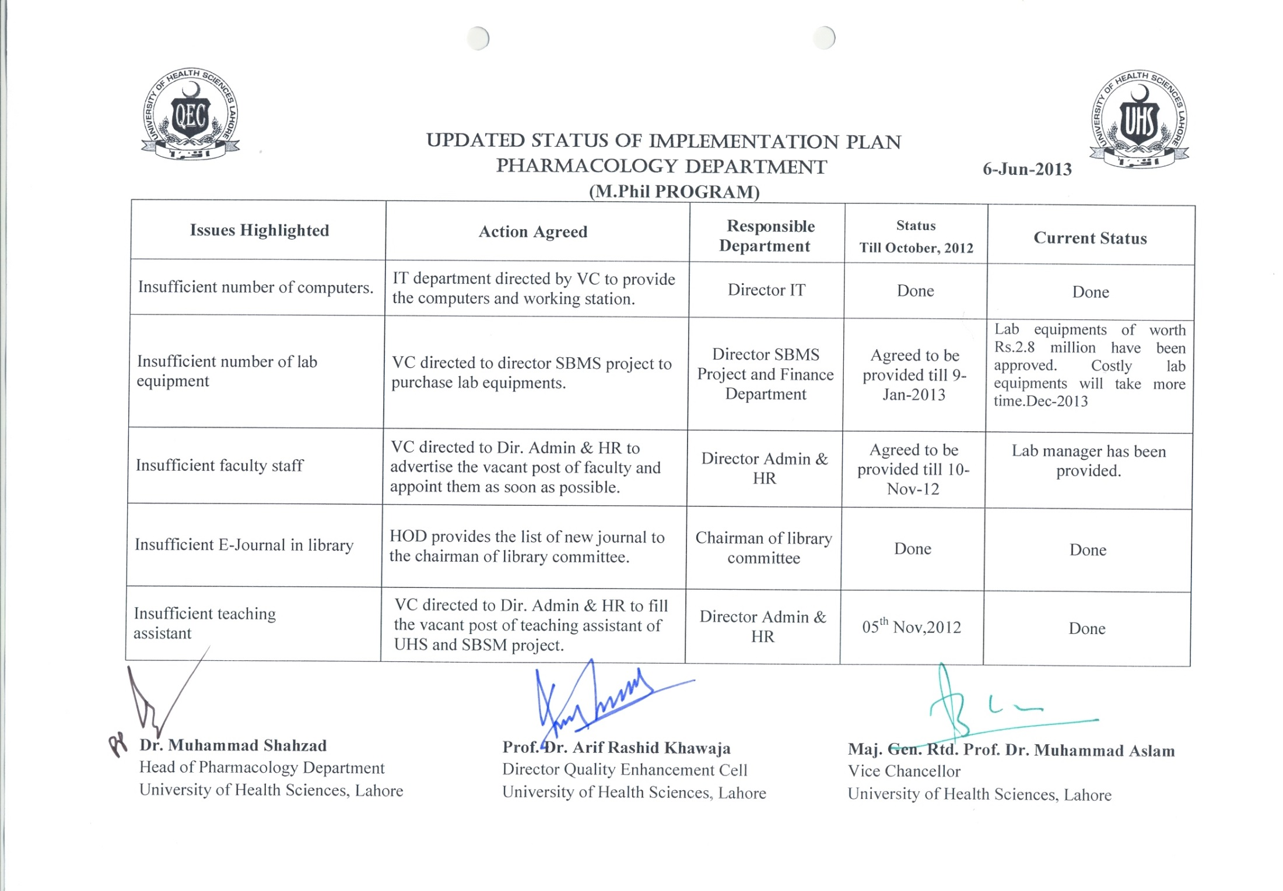
M. Phil Pharmacology

Slide 23
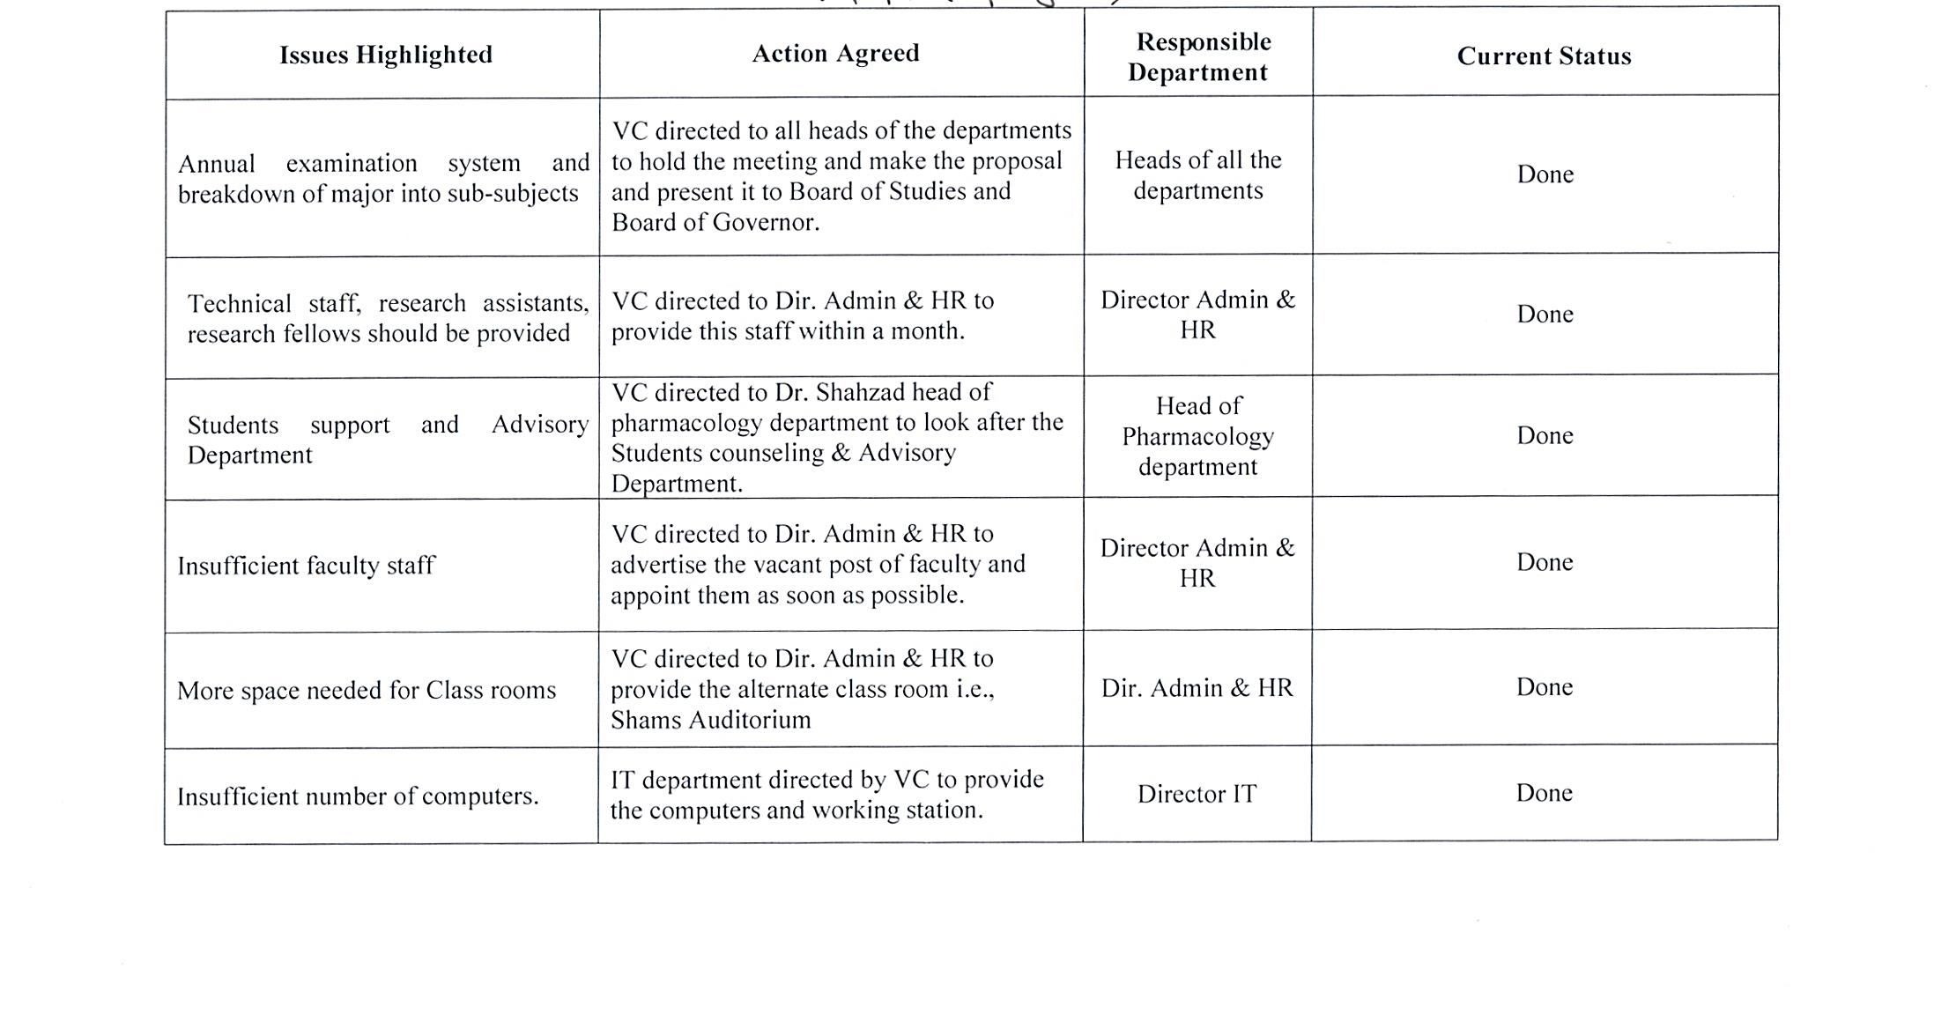
M. Phil Physiology & Cell Biology

Slide 24
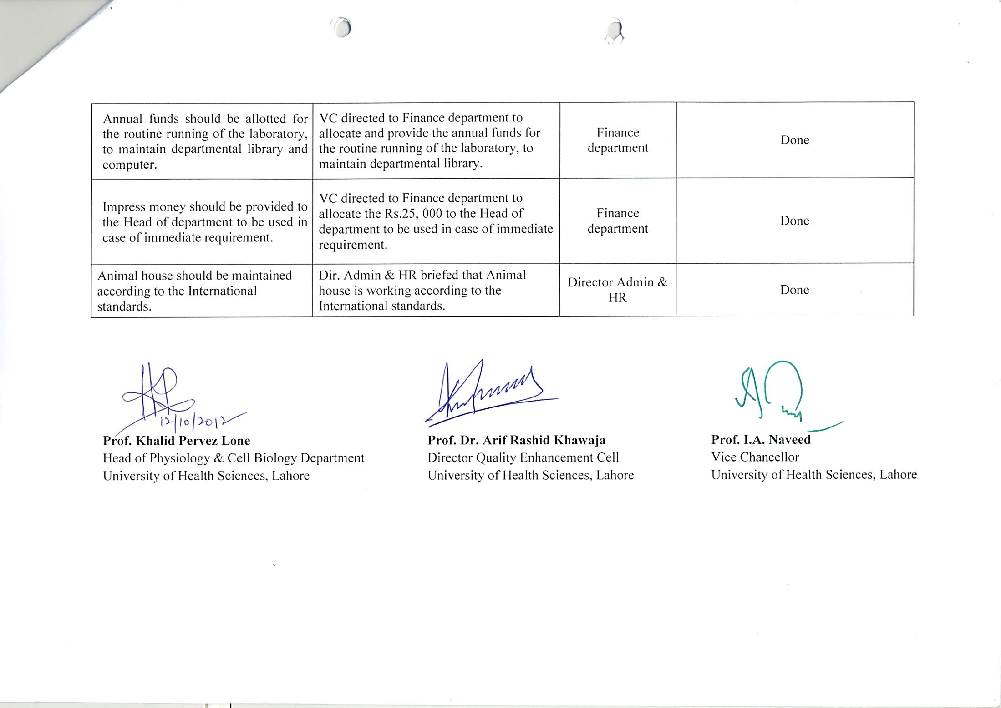
M. Phil Physiology & Cell Biology

Slide 25
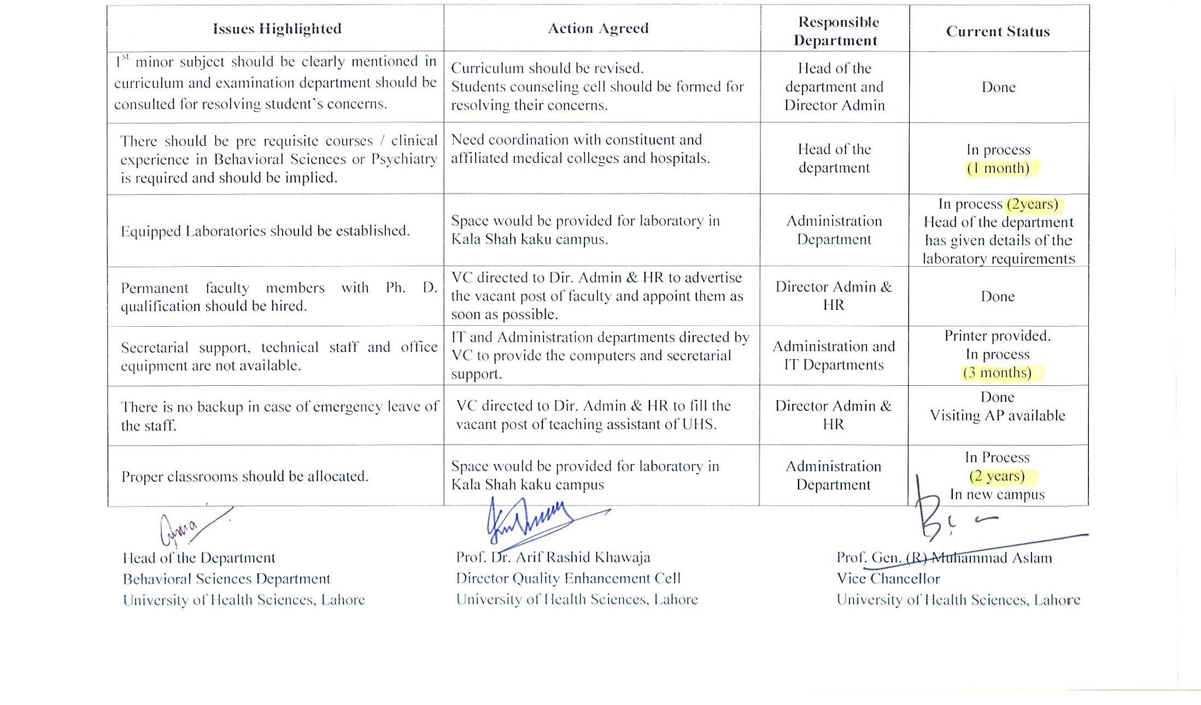
M. Phil Behavioral Sciences

Slide 26
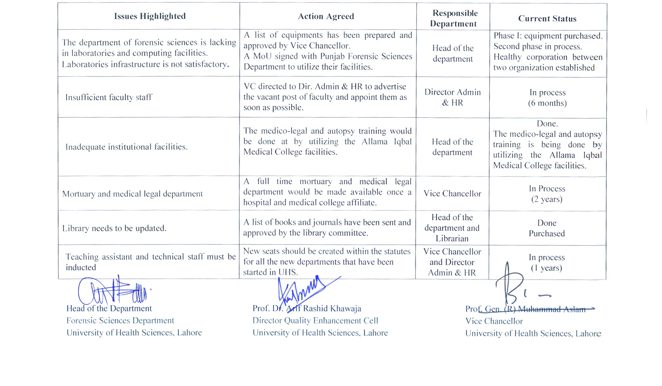
M. Phil Forensic Medicine & Toxicology

Slide 27
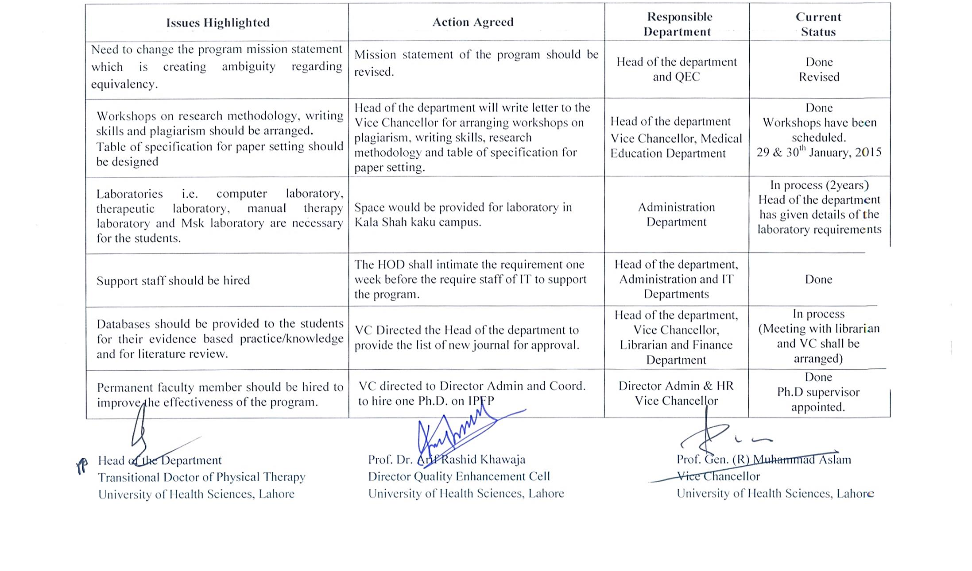
Transitional Doctor of Physiotherapy (T-DPT)

Slide 28
INTERNATIONAL SEMINARS & CONFERENCES 2014-15

Slide 29
International Seminars & Conferences 2014-15:
Quality Assurance Week
Quality Assurance Seminar
Participation of VC in International Conference on Quality Assurance 2014 at Bangkok

Slide 30
Quality Assurance Week
Quality Assurance Awareness Week was organized by the Quality Enhancement Cell at University of Health Sciences from 14 to 18th April 2014. A number of flexes with basic information about Quality Assurance in Higher Education was placed all around the campus during the week.

Slide 31
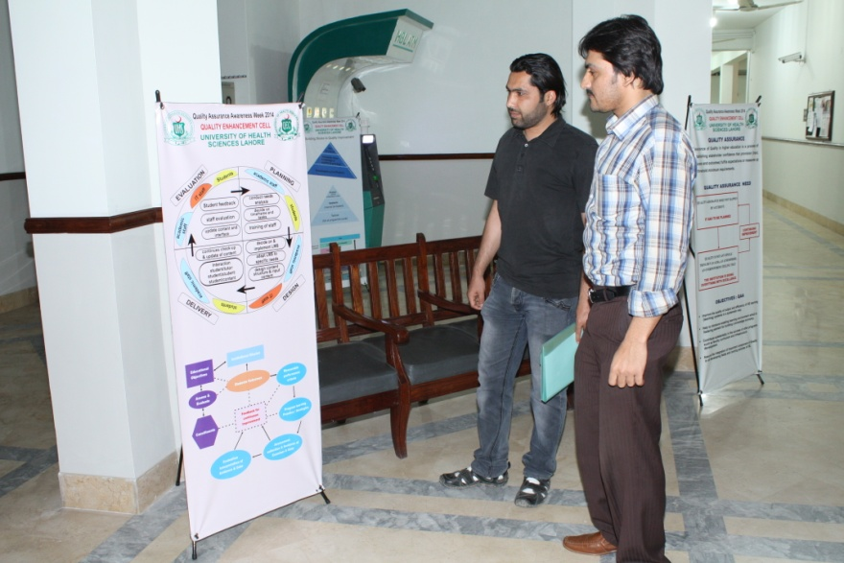
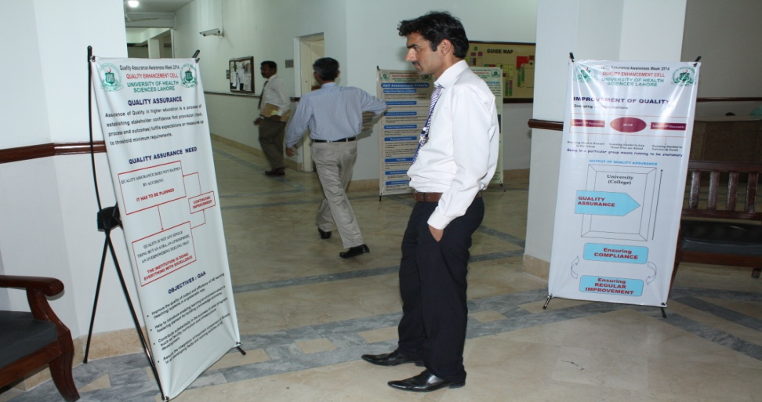
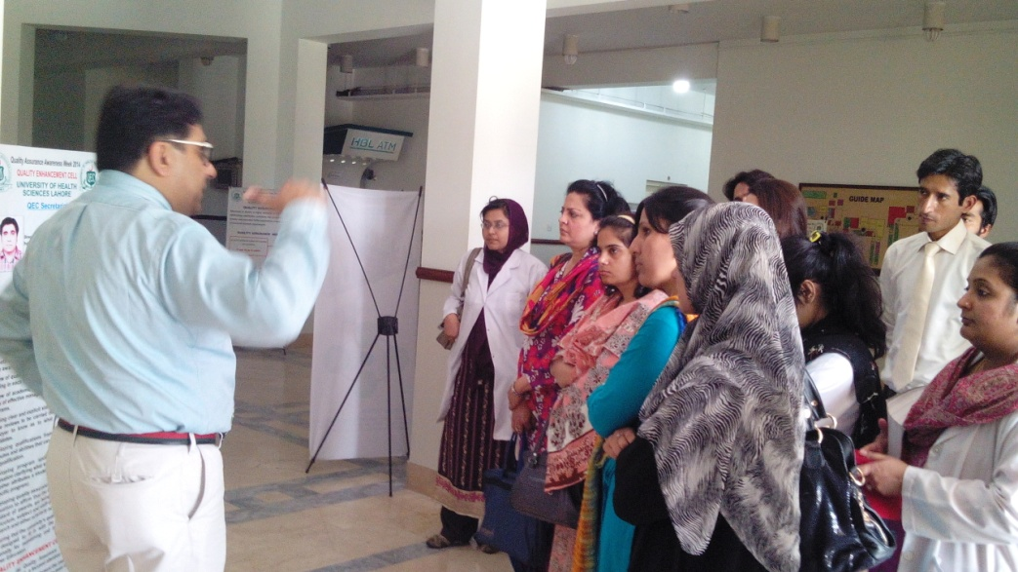
Quality Assurance Week Poster Presentation

Slide 32
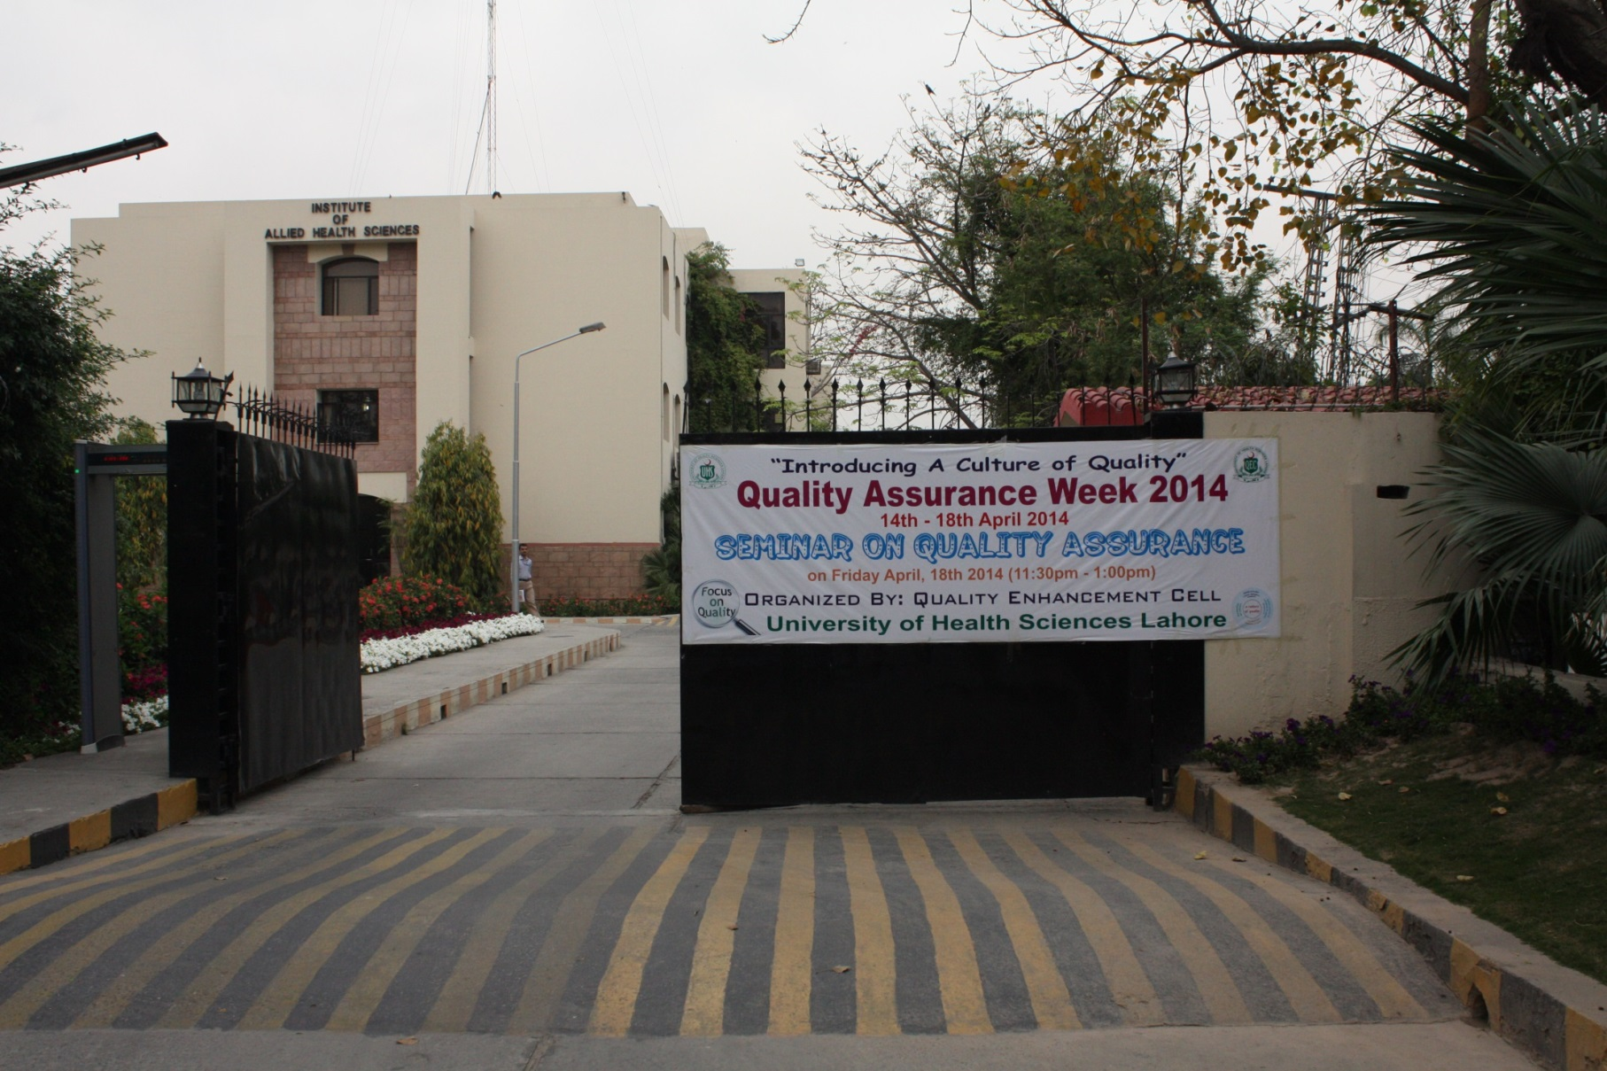
Quality Assurance Week

Slide 33
Quality Assurance Seminar

Slide 34
Quality Assurance Seminar

Slide 35
Quality Assurance Seminar
The QA awareness week was from 14th April till 18th April, 2014 inclusive. The week ended with Quality Assurance seminar in which explained the role and various activities of QEC at UHS along with its role in the national and international ranking of the university.

Slide 36
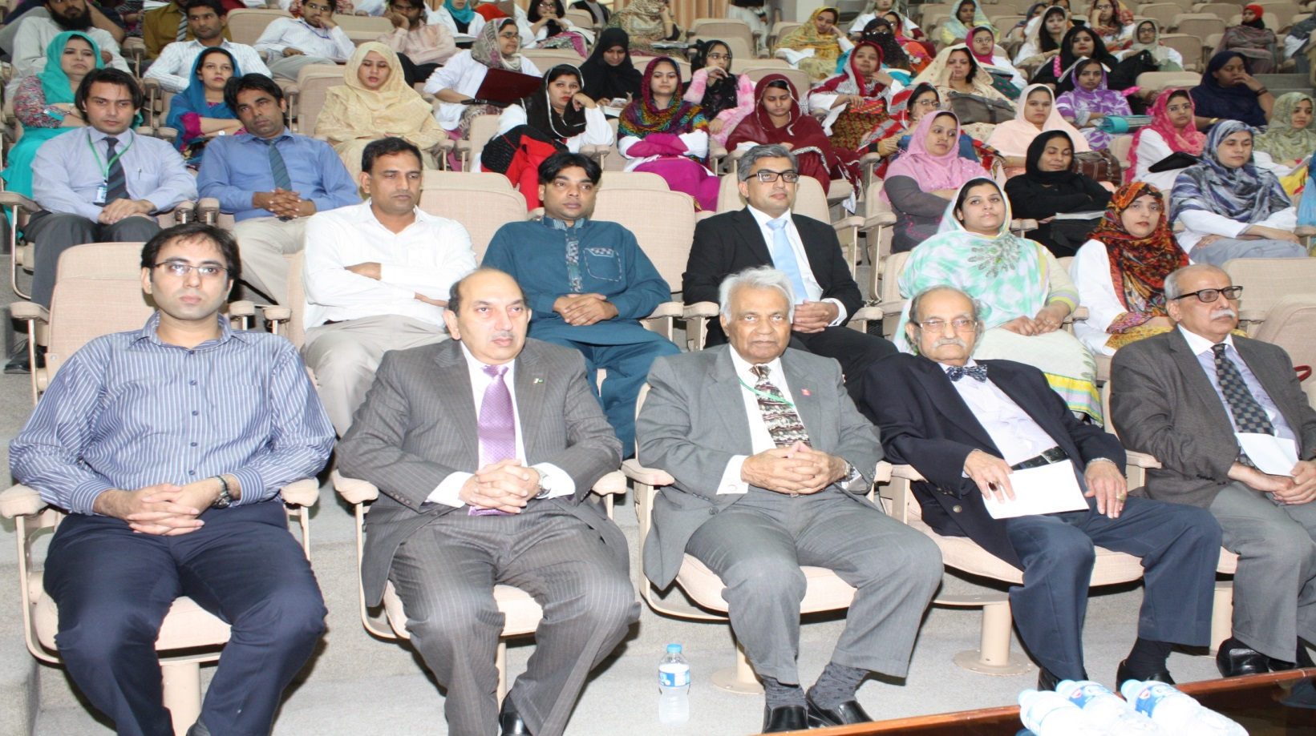
Quality Assurance Seminar

Slide 37
Quality Assurance Seminar

Slide 38
Quality Assurance Seminar

Slide 39
Quality Assurance Seminar

Slide 40
Participation of VC in International Conference on Quality Assurance 2014 at Bangkok
The Office for National Education Standards and Quality Assessment (ONESQA) based in Bangkok, Thailand, organized the International Conference on Quality Assurance 2014 (ICQA2014) on the theme “Quality Assurance, Quality Building and Quality Culture” from December 8th – 10th, 2014 at the Bangkok International Trade and Exhibition Centre (BITEC), Bangna, Bangkok.
This conference was attended by the worthy Vice Chancellor of UHS.

Slide 41
Participation of VC in International Conference on Quality Assurance 2014 at Bangkok
The purposes of this conference were to share information on quality assurance practices, experiences, and achievement, and to bolster a mutual understanding and commitment to quality assurance

Slide 42
Online Survey for Teachers and Course Evaluation by Students
The Quality Enhancement Cell at University of Health Sciences will arrange a workshop on online filling of the proformas and to discuss each and every item in course and teacher evaluation proformas by the end of this month.

