Slide 1
University of Health Sciences, Lahore 2nd Meeting of Phase-III QECs
[Reporting Period: July – Nov 2010
Presented By: Prof. Dr. Arif Rashid Khawaja
FRCS(Ed), FRCS (Gen Surg), CCST
Director Centre of Innovation in Learning & Teaching (CILT)

Slide 2
QEC SECRETARIAT ESTABLISHMENT
Advertisement Date: 07-11-2009
Interviews Date for Deputy Director: 29-05-2010
Headed by: Prof. Amiir Ijaz
Head of Department QA University of Punjab
Deputy Director Selection: 07-06-2010
Deputy Director Joining: 14-06-2010
Unfortunately not given deputation therefore did not take up the post.

Slide 3
Procurement of QEC Equipment in line with provision of PC-1
S. No | Name Of Equipment | Quantity | Purchase Date | Installation Date | Purchased from (Univ contribution/HEC)
1 | Computers | 02
2 | Fax Machine | 01
3 | Photo copier | 01
4 | Laser Printer | 01
5 | Other (if any) | 01
Procurement would take place after the induction of the Deputy Director in the next few months (maximum six(06) months).

Slide 4
Recruitment Status of QEC Staff
Posts | Status |  |  | Date of appointment | Salary
 | Permanent | Contract | Additional Charge
Director
Deputy Director
Data Analyst
Personal Assistant
NQ
Additional Posts
Appointment for Deputy director was made but because of his inability to join, further recruitment could not take place. It is hoped that all staff would be appointed after the selection of Director/Deputy Director in the next six (06) months.

Slide 5
Awareness seminars/conferences/ workshops arranged at University on QA
S. No | Title of the event | Date | Target group | Purpose of the event
A Member of the University has attended workshops arranged by HEC on Quality Assurance.

Slide 6
Examination evaluation proformas given to all MCAT applicants in 2009 and 2010 which equals about 68000 students. Similar evaluation proformas given to all medical students taking part in various professional examinations. Recently employees and supervisors survey has been sent to all the employees from BPS11 to BPS16 and the process would continue to higher grades also. A full time statistical officer at the UHS would prepare performance evaluation of employees ,students and supervisors. A dedicated office for quality assurance called QAC has been setup that is currently under the DME and CILT till the post for Director/Deputy Director QAC has been appointed.
IMPLEMENTATION STATUS OF QA MECHANISM

Slide 7
Compilation of Program Team Reports in Four selected Departments (SARs to be submitted to QAA-HEC)

Slide 8
SELF ASSESSMENT EXERCISE
S. No | Departments undertaking SA exercise | PTs formed (Yes/No) | Program Team Report completed |  |  | QEC Review of the Program Teams Report
 |  |  | No. of Criteria covered ( out of 8) | No. of Standards covered (out of 31) | No. & Type of Surveys completed ( out of 10) | Date of submission of the report by the PT | Report if returned to PT and further submission by PT(Specify Dates) | Report finalized (Date)
Proformas’ of various headings are attached.

Slide 9
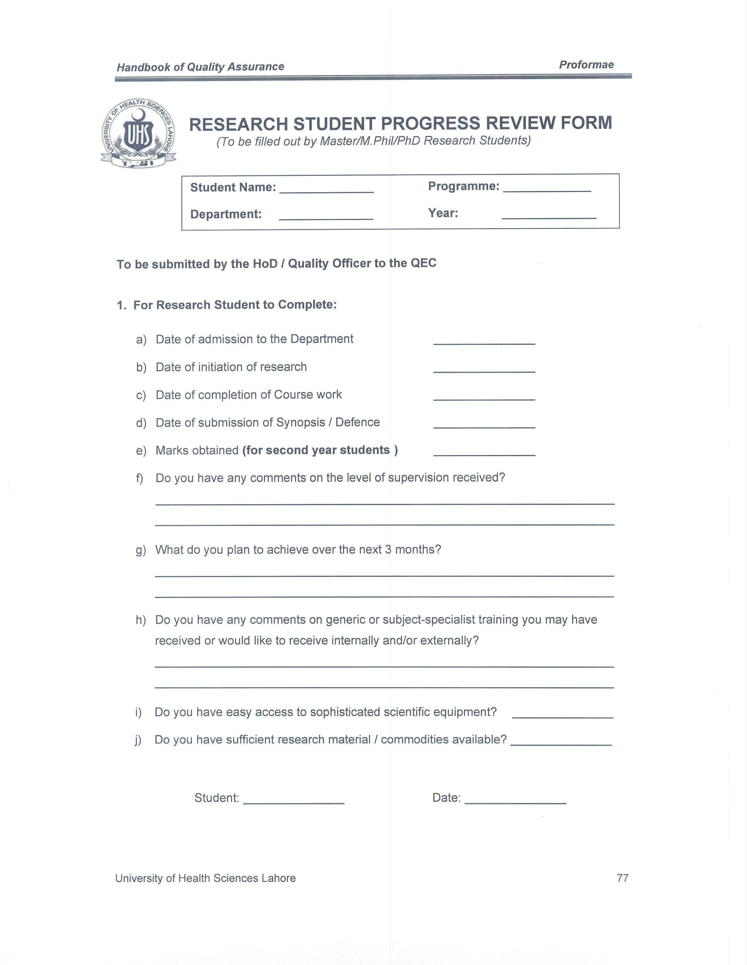
Research Student Progress Review Form

Slide 10
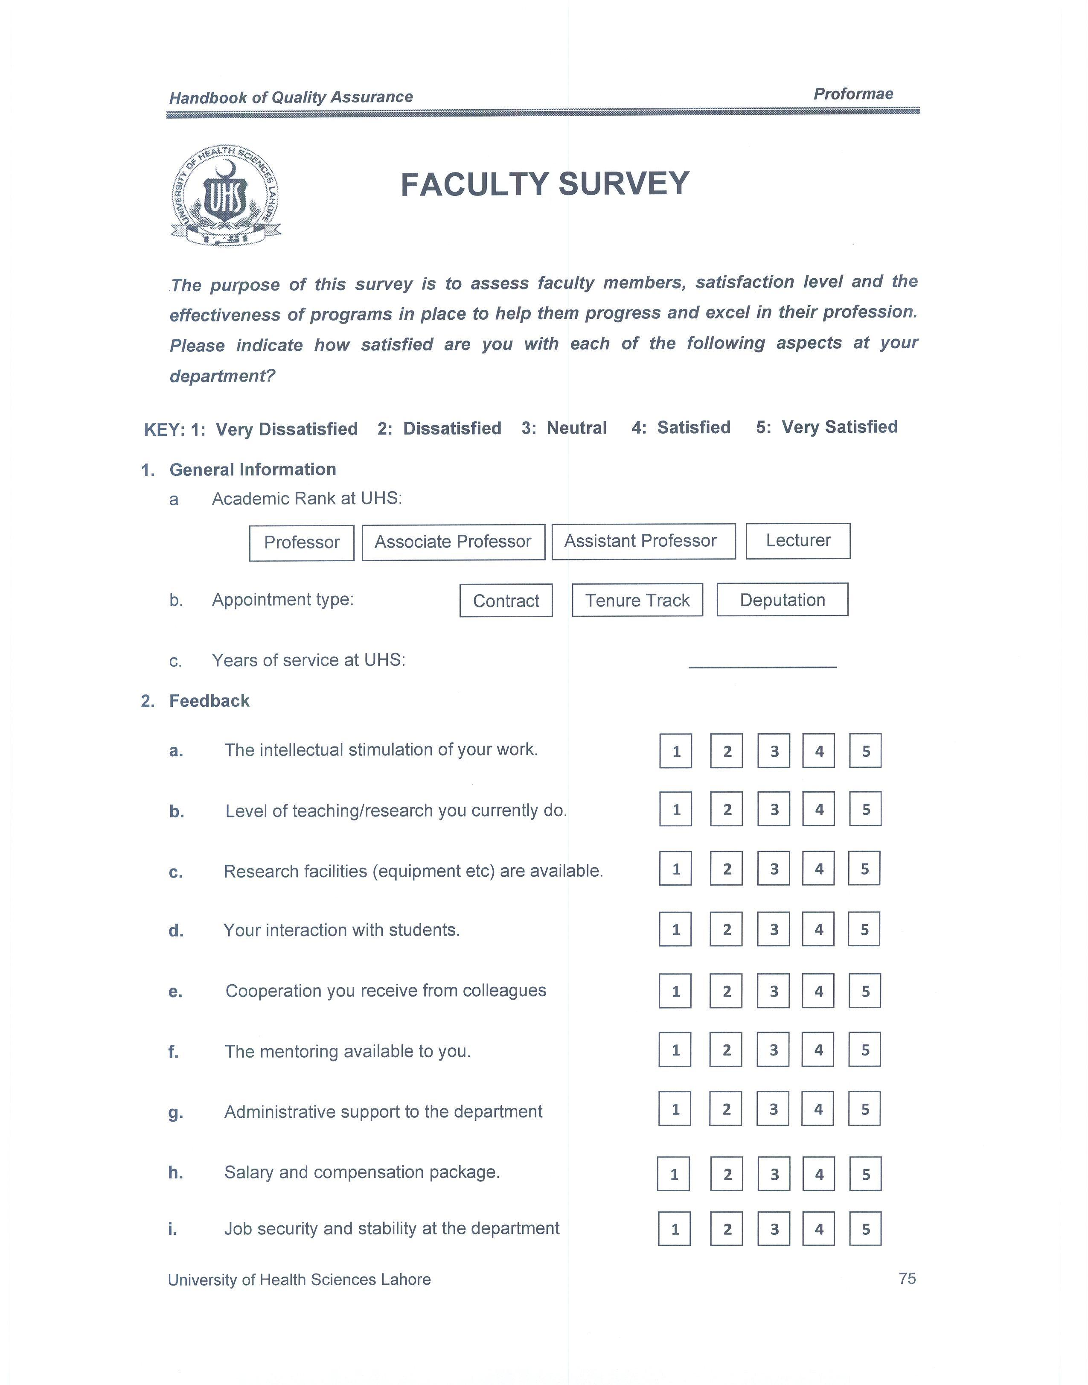
Faculty Survey

Slide 11
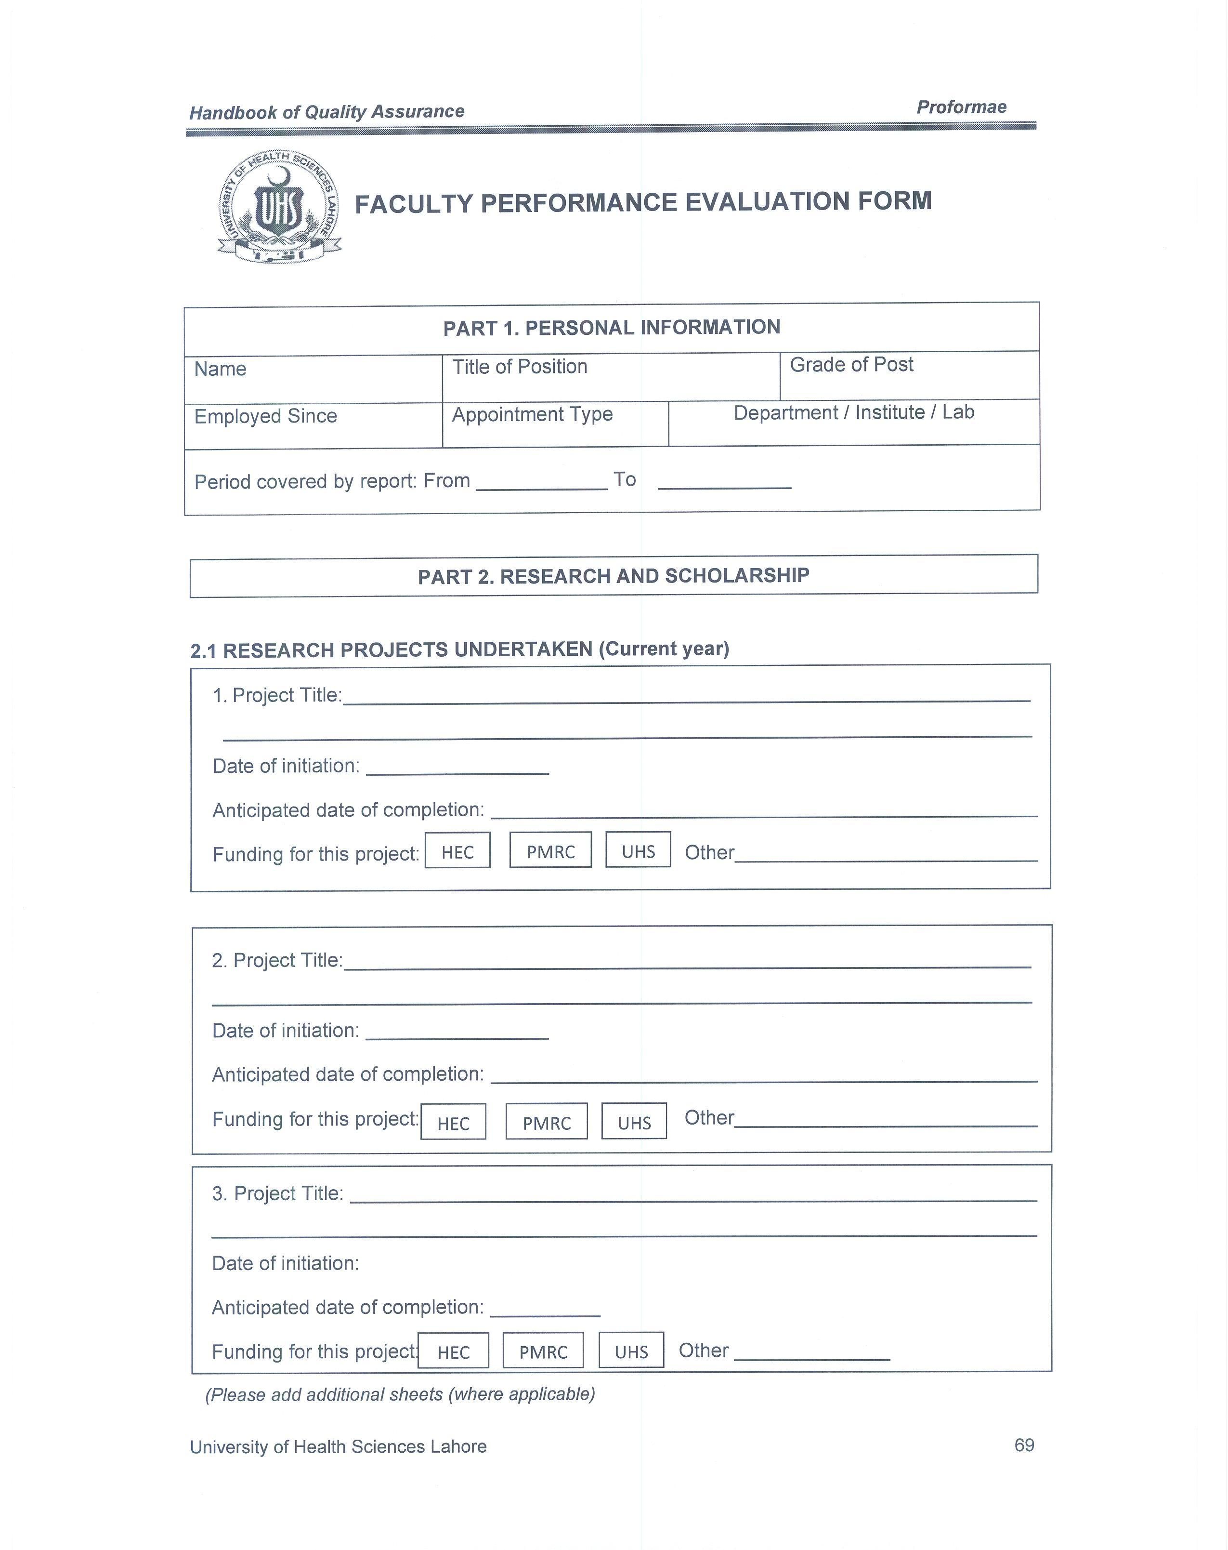
Faculty Professional Evaluation Form

Slide 12
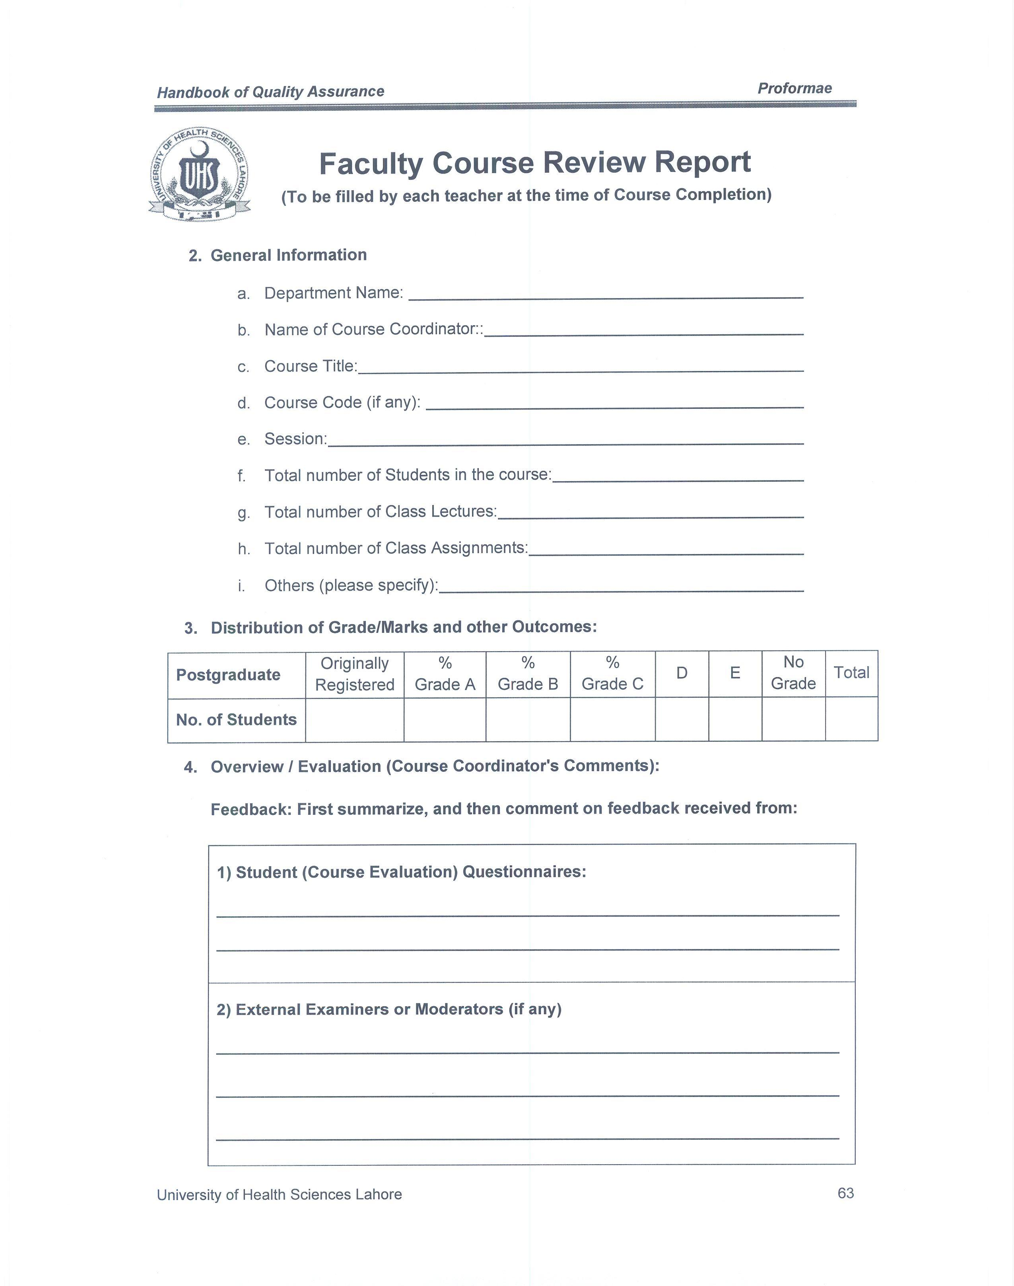
Faculty Course Review Report

Slide 13
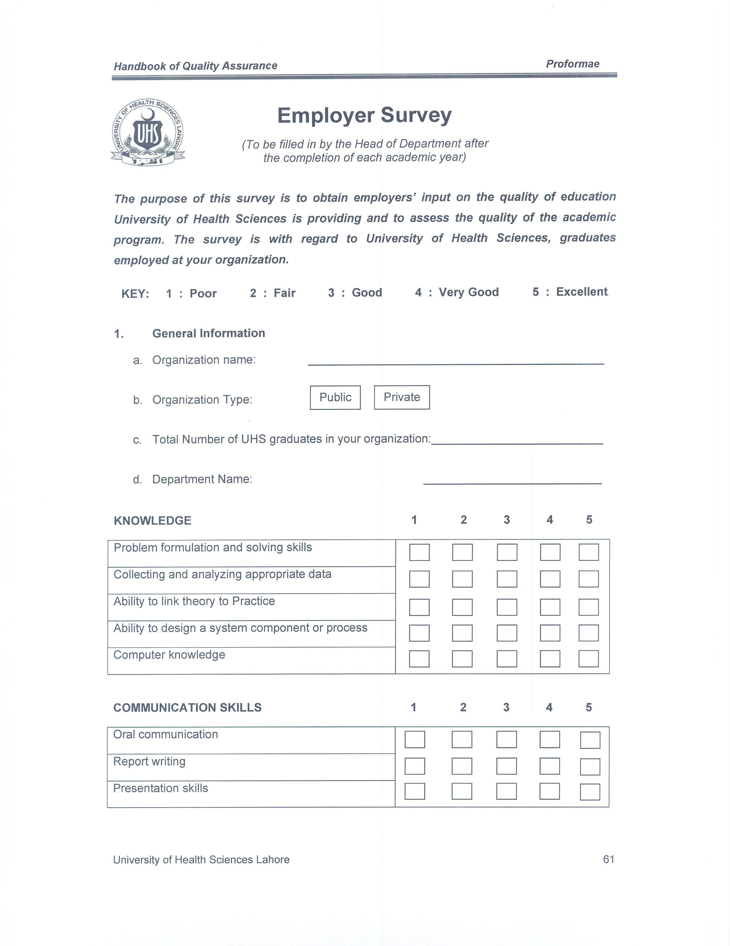
Employer Survey

Slide 14
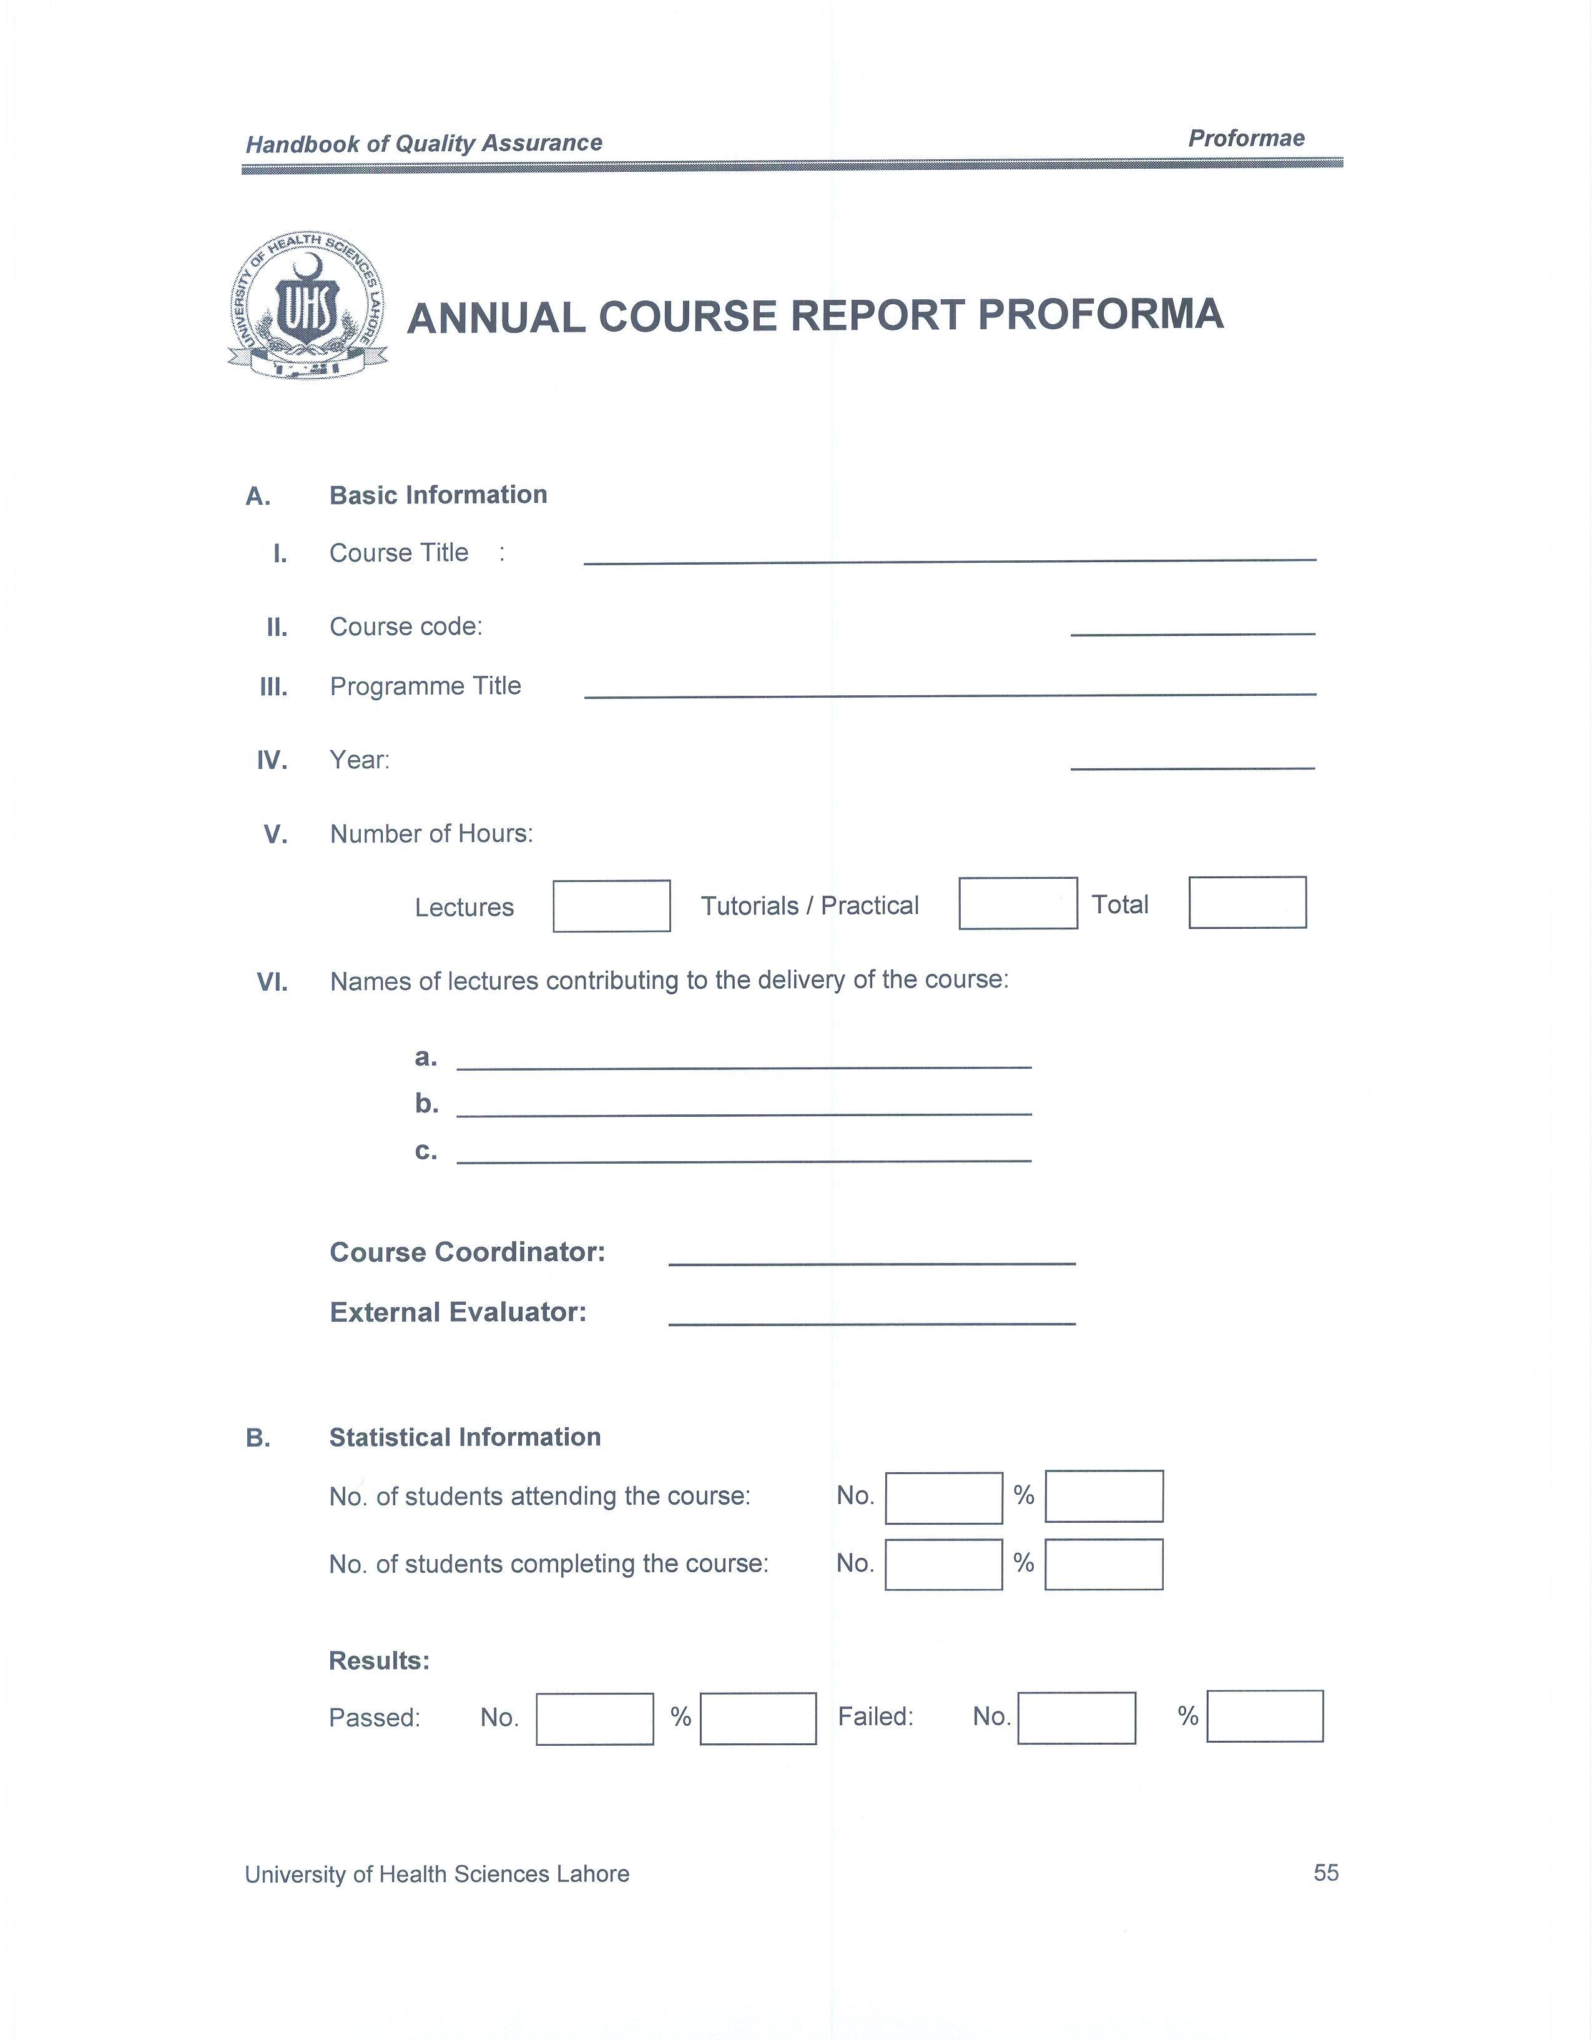
Annual Course Report Proforma

Slide 15
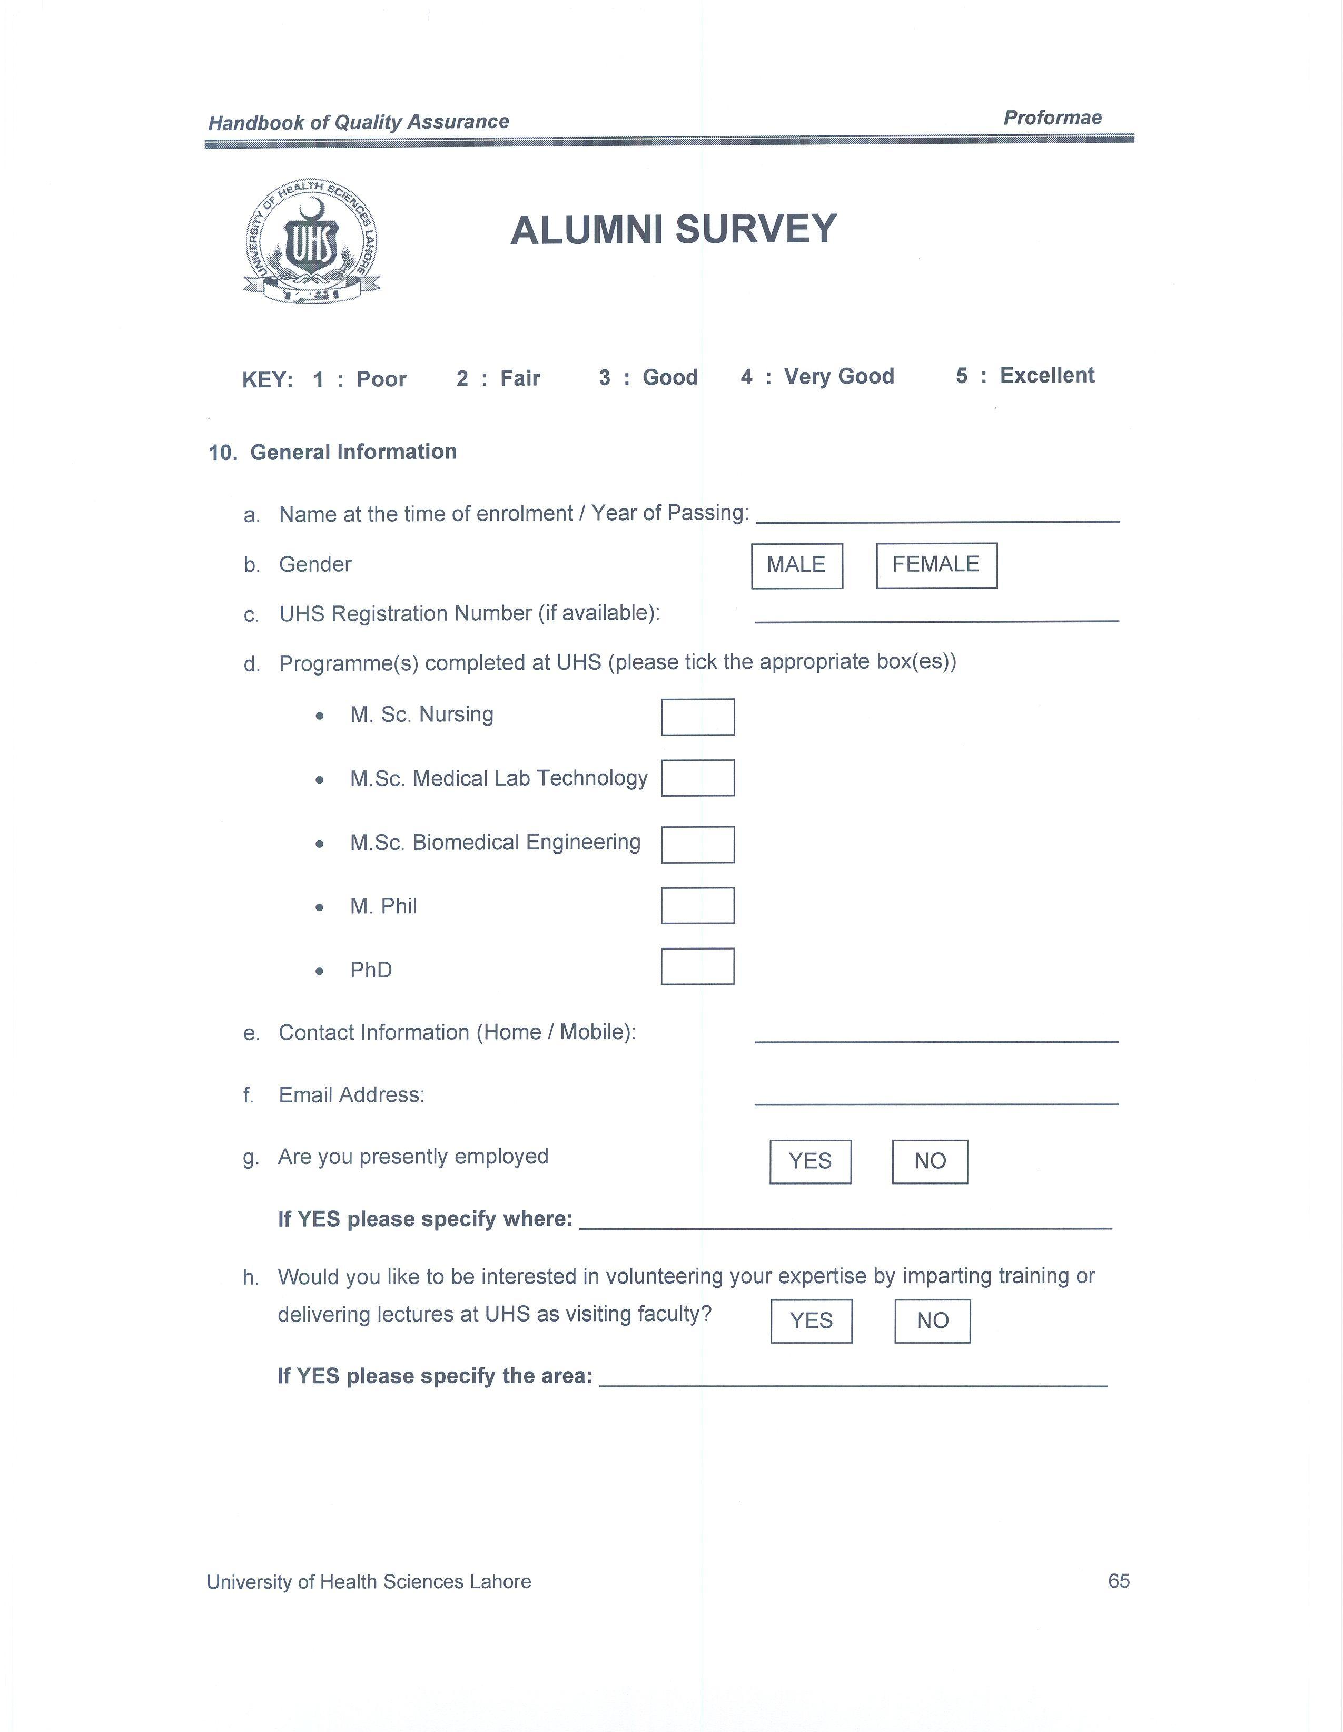
Alumni Survey

Slide 16
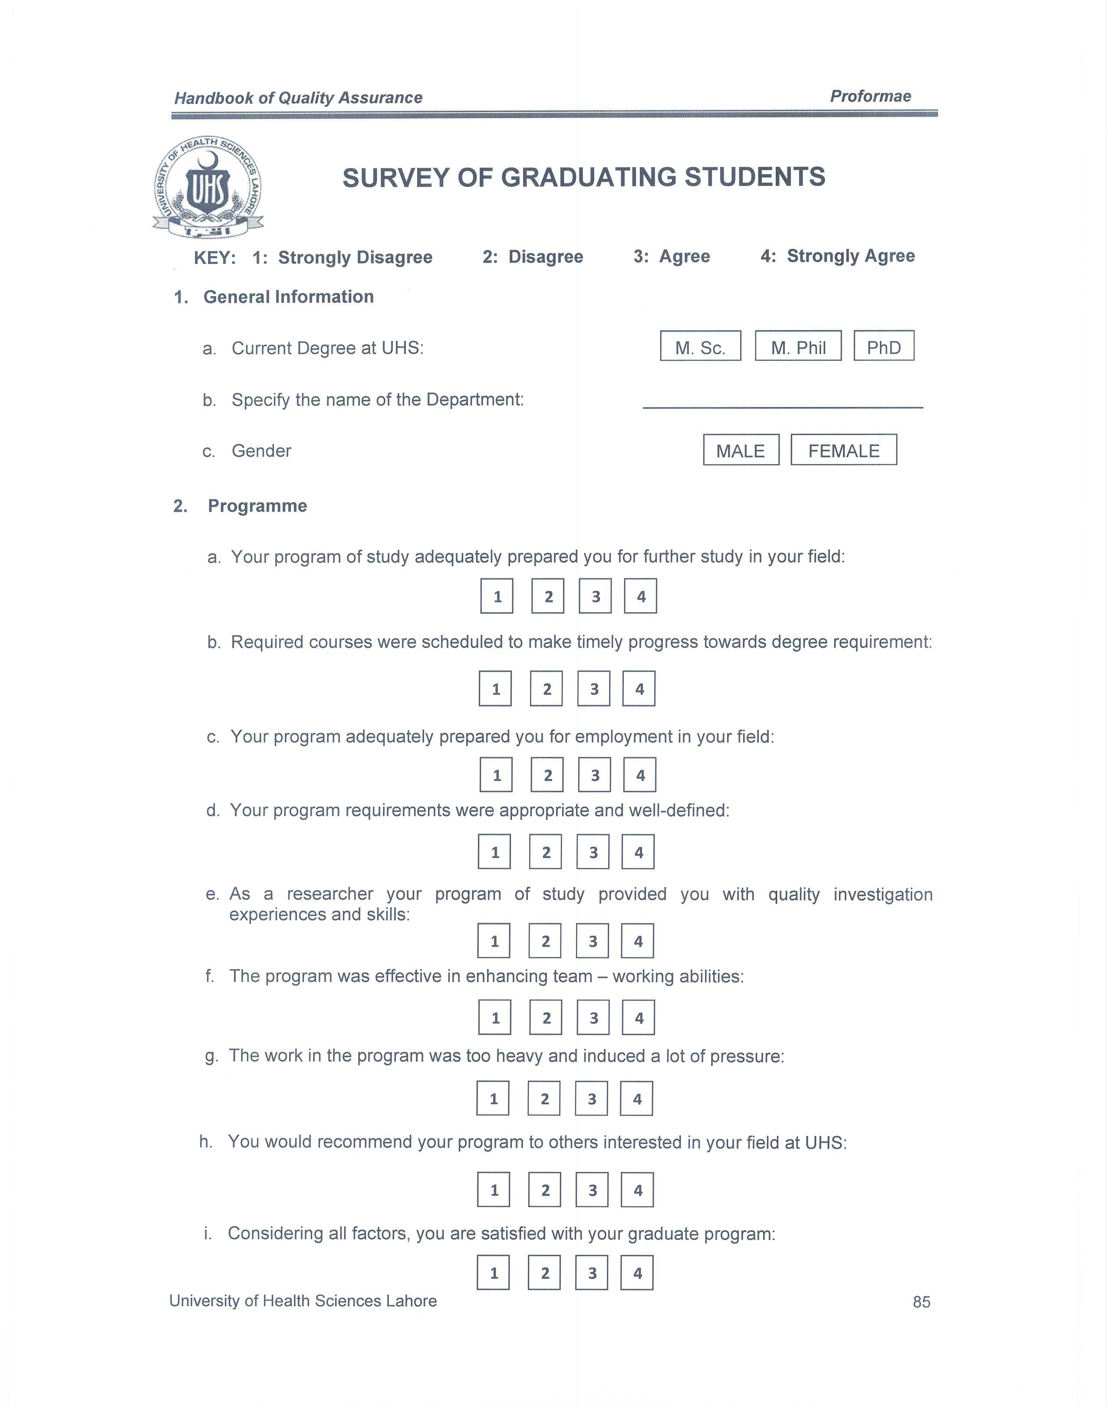
Survey of Graduating Students

Slide 17
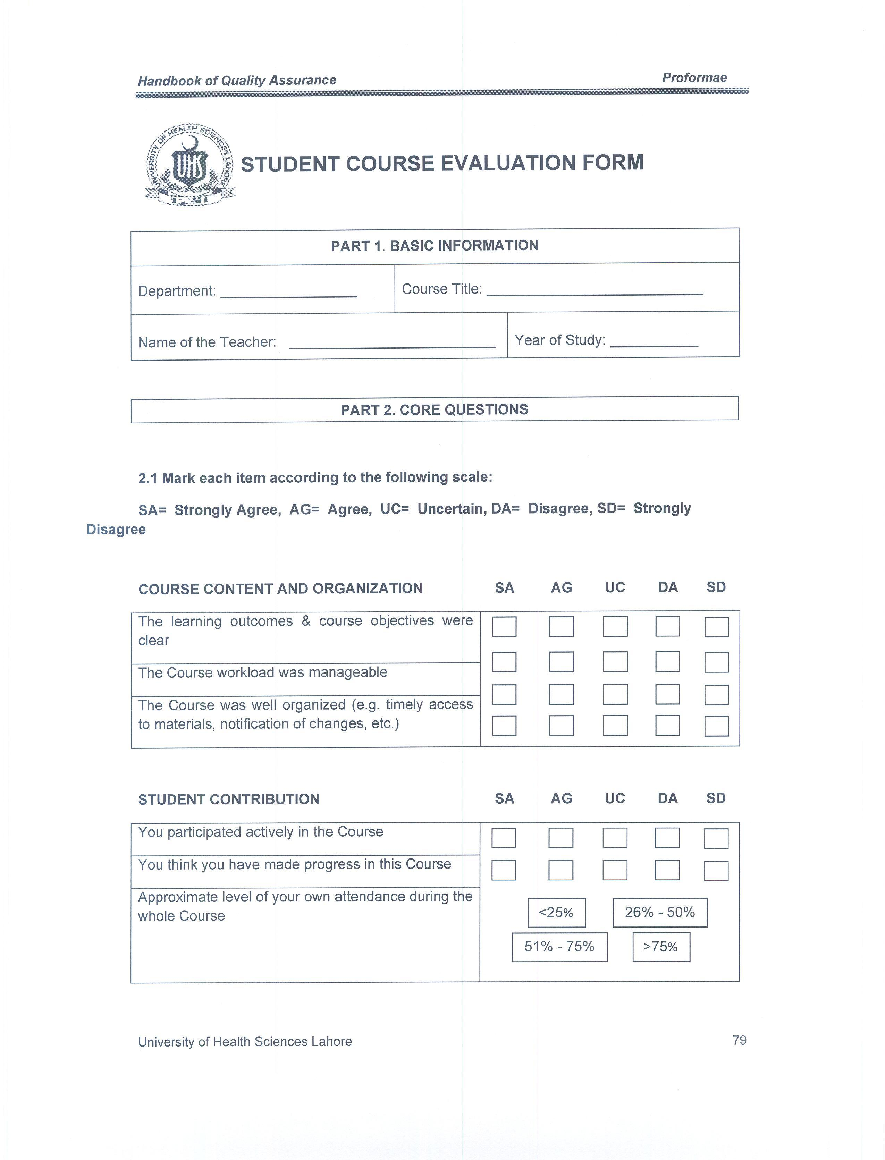
Student Course Evaluation Form

Slide 18
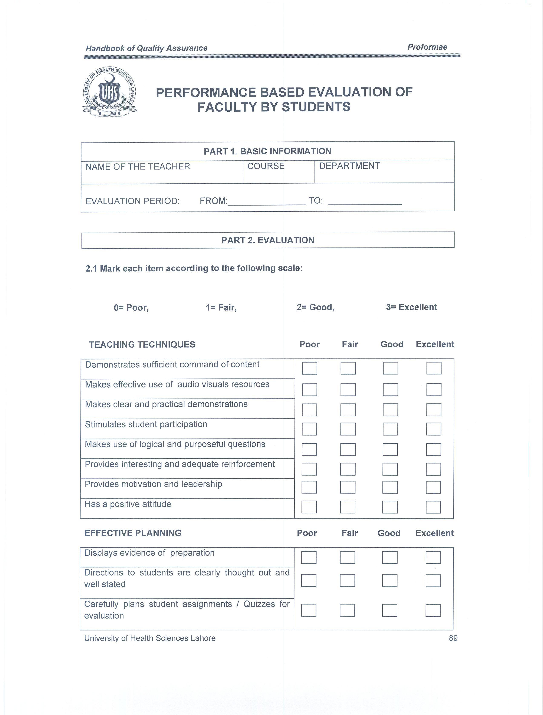
Performance Based Evaluation of Faculty By Students

Slide 19
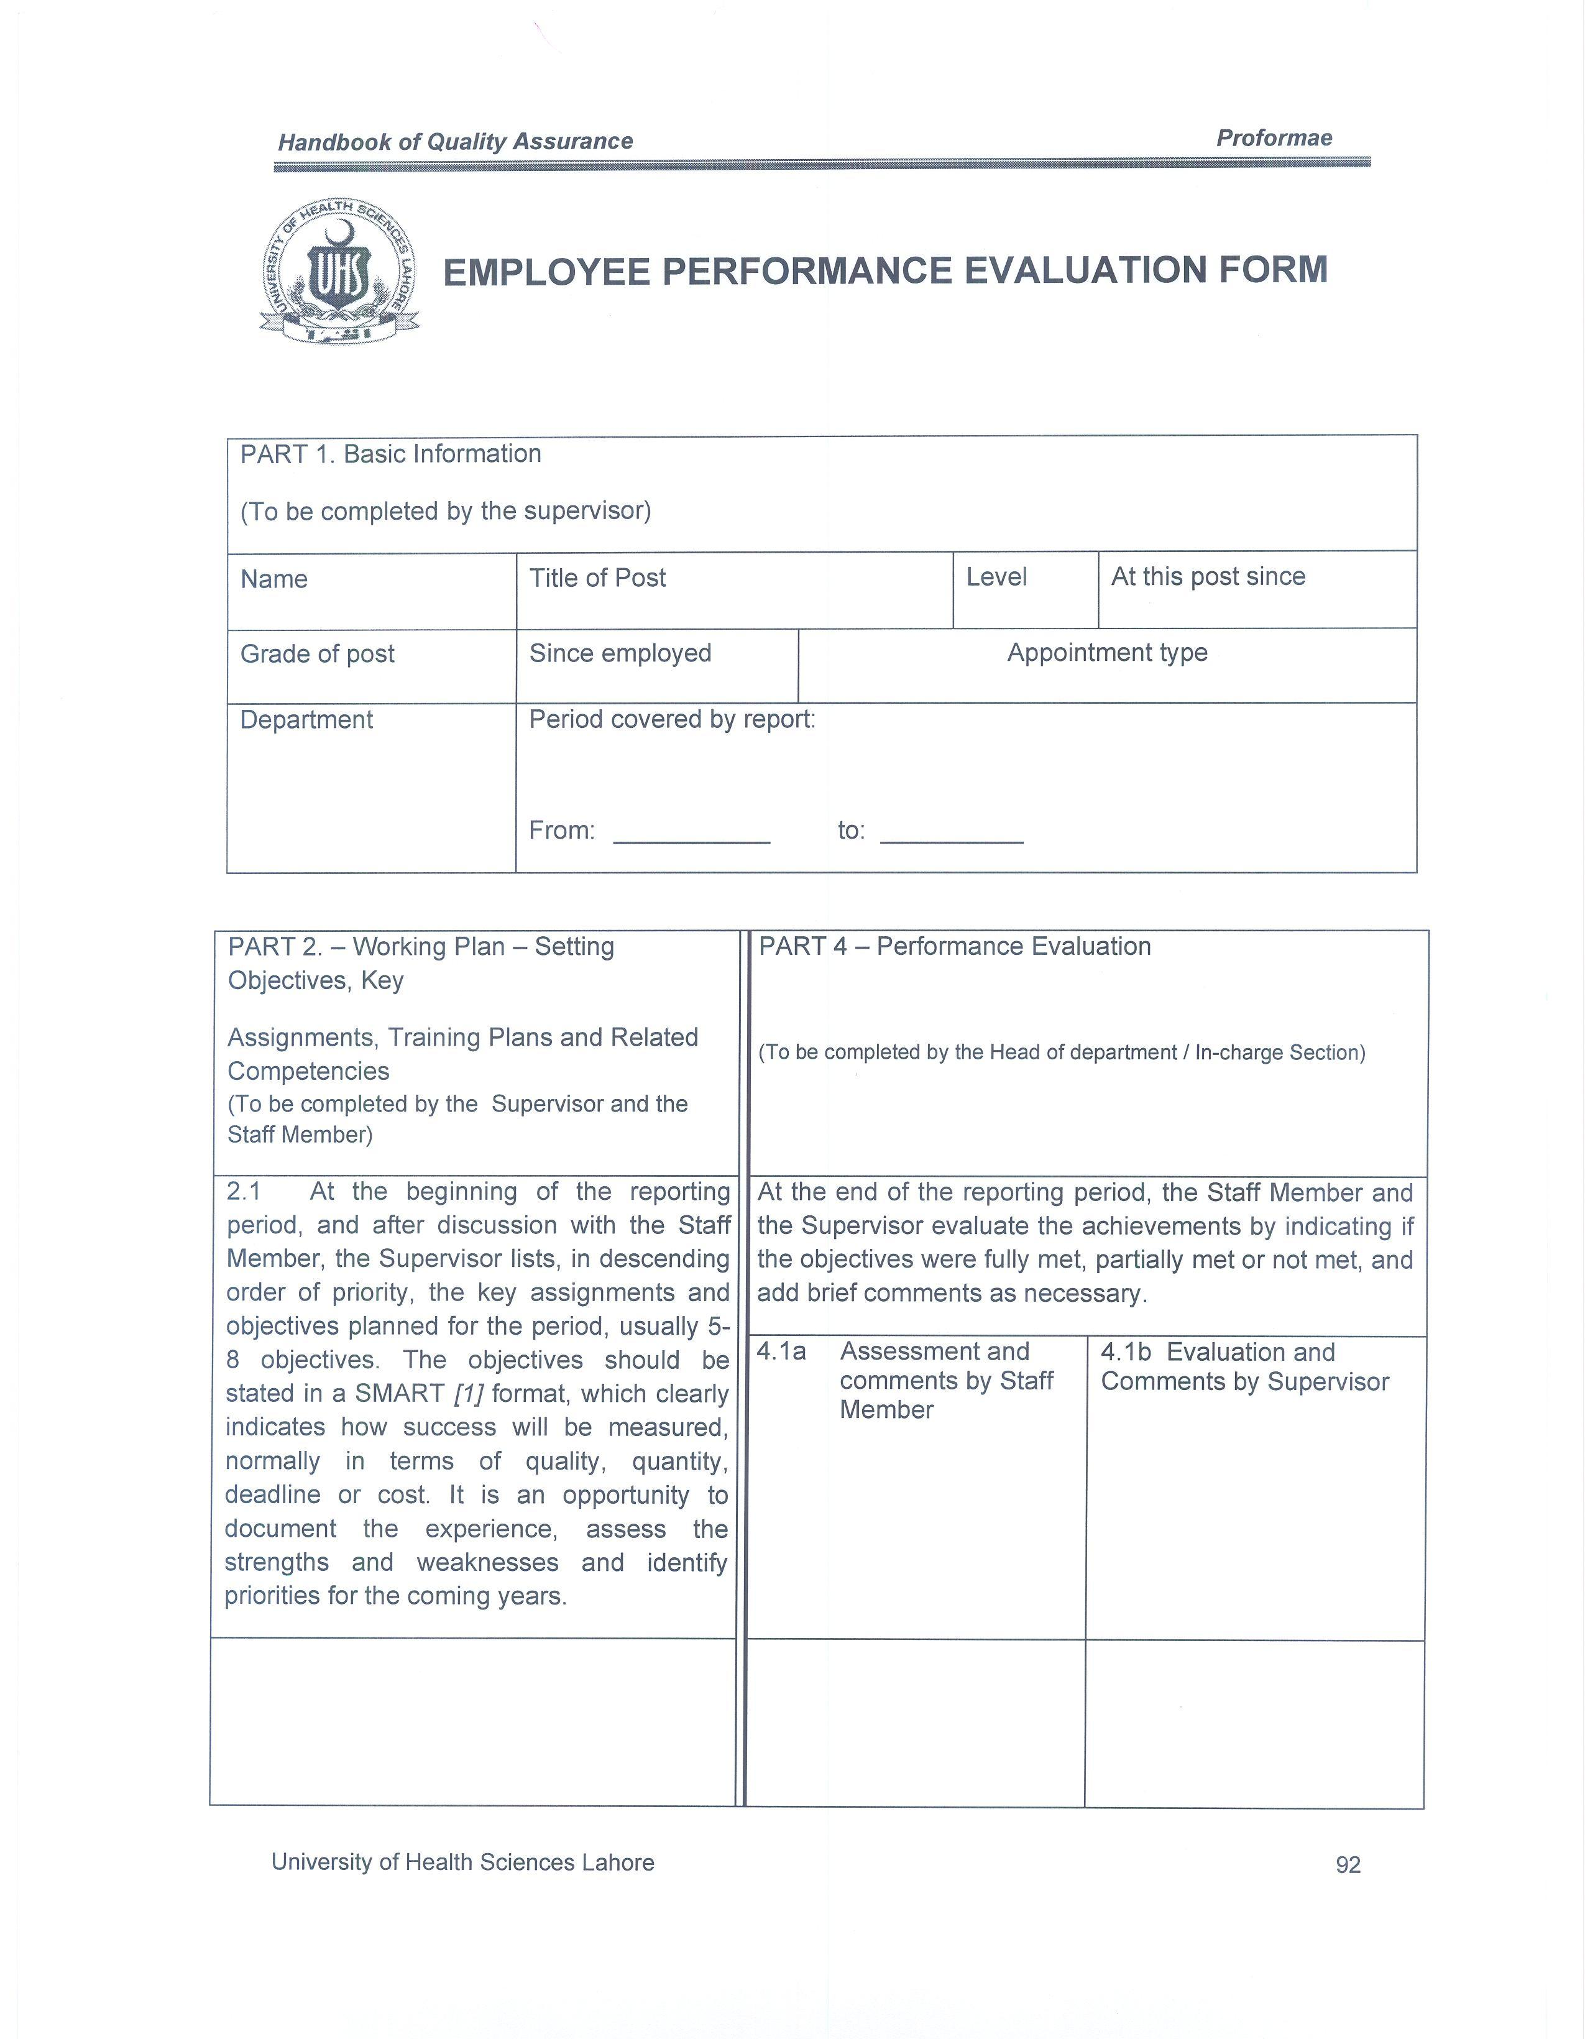
Employee Performance Evaluation Form

Slide 20
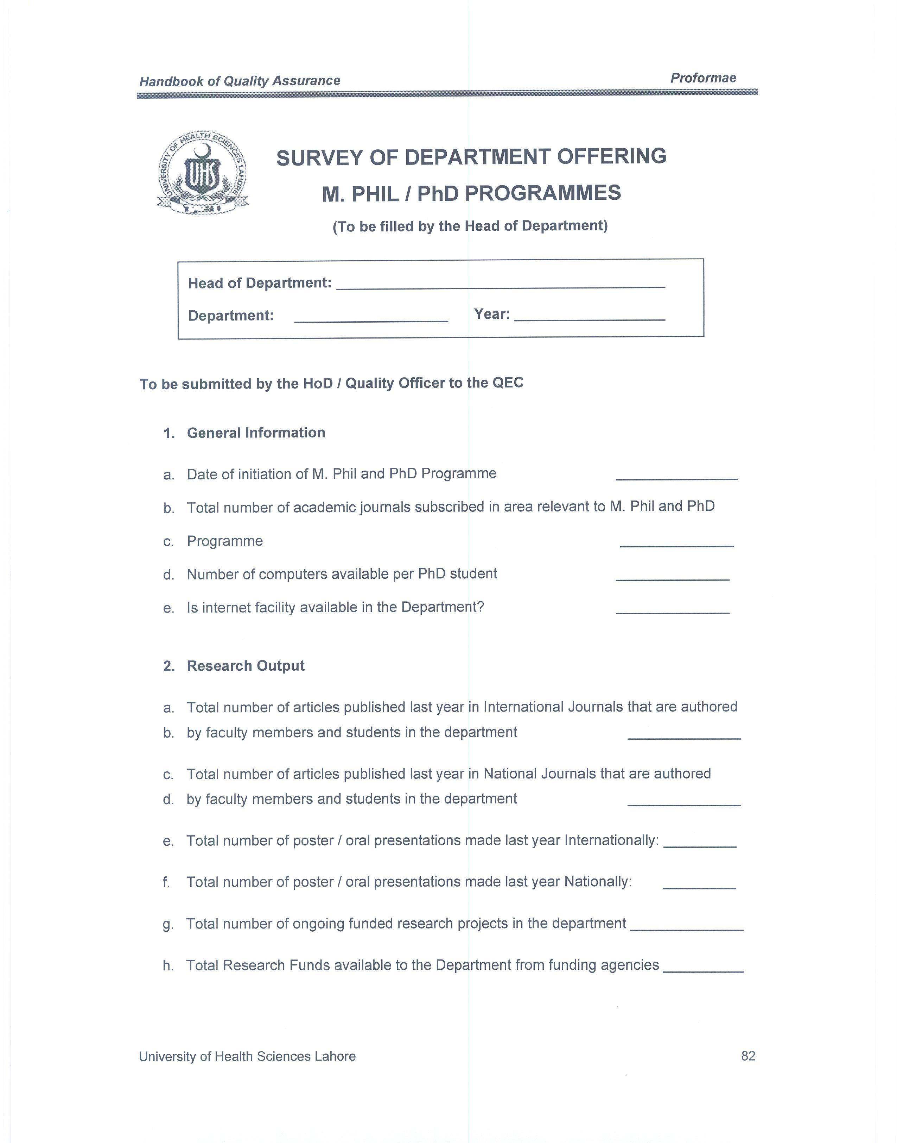
Survey of Department Offering M.Phil/Ph.D

Slide 21
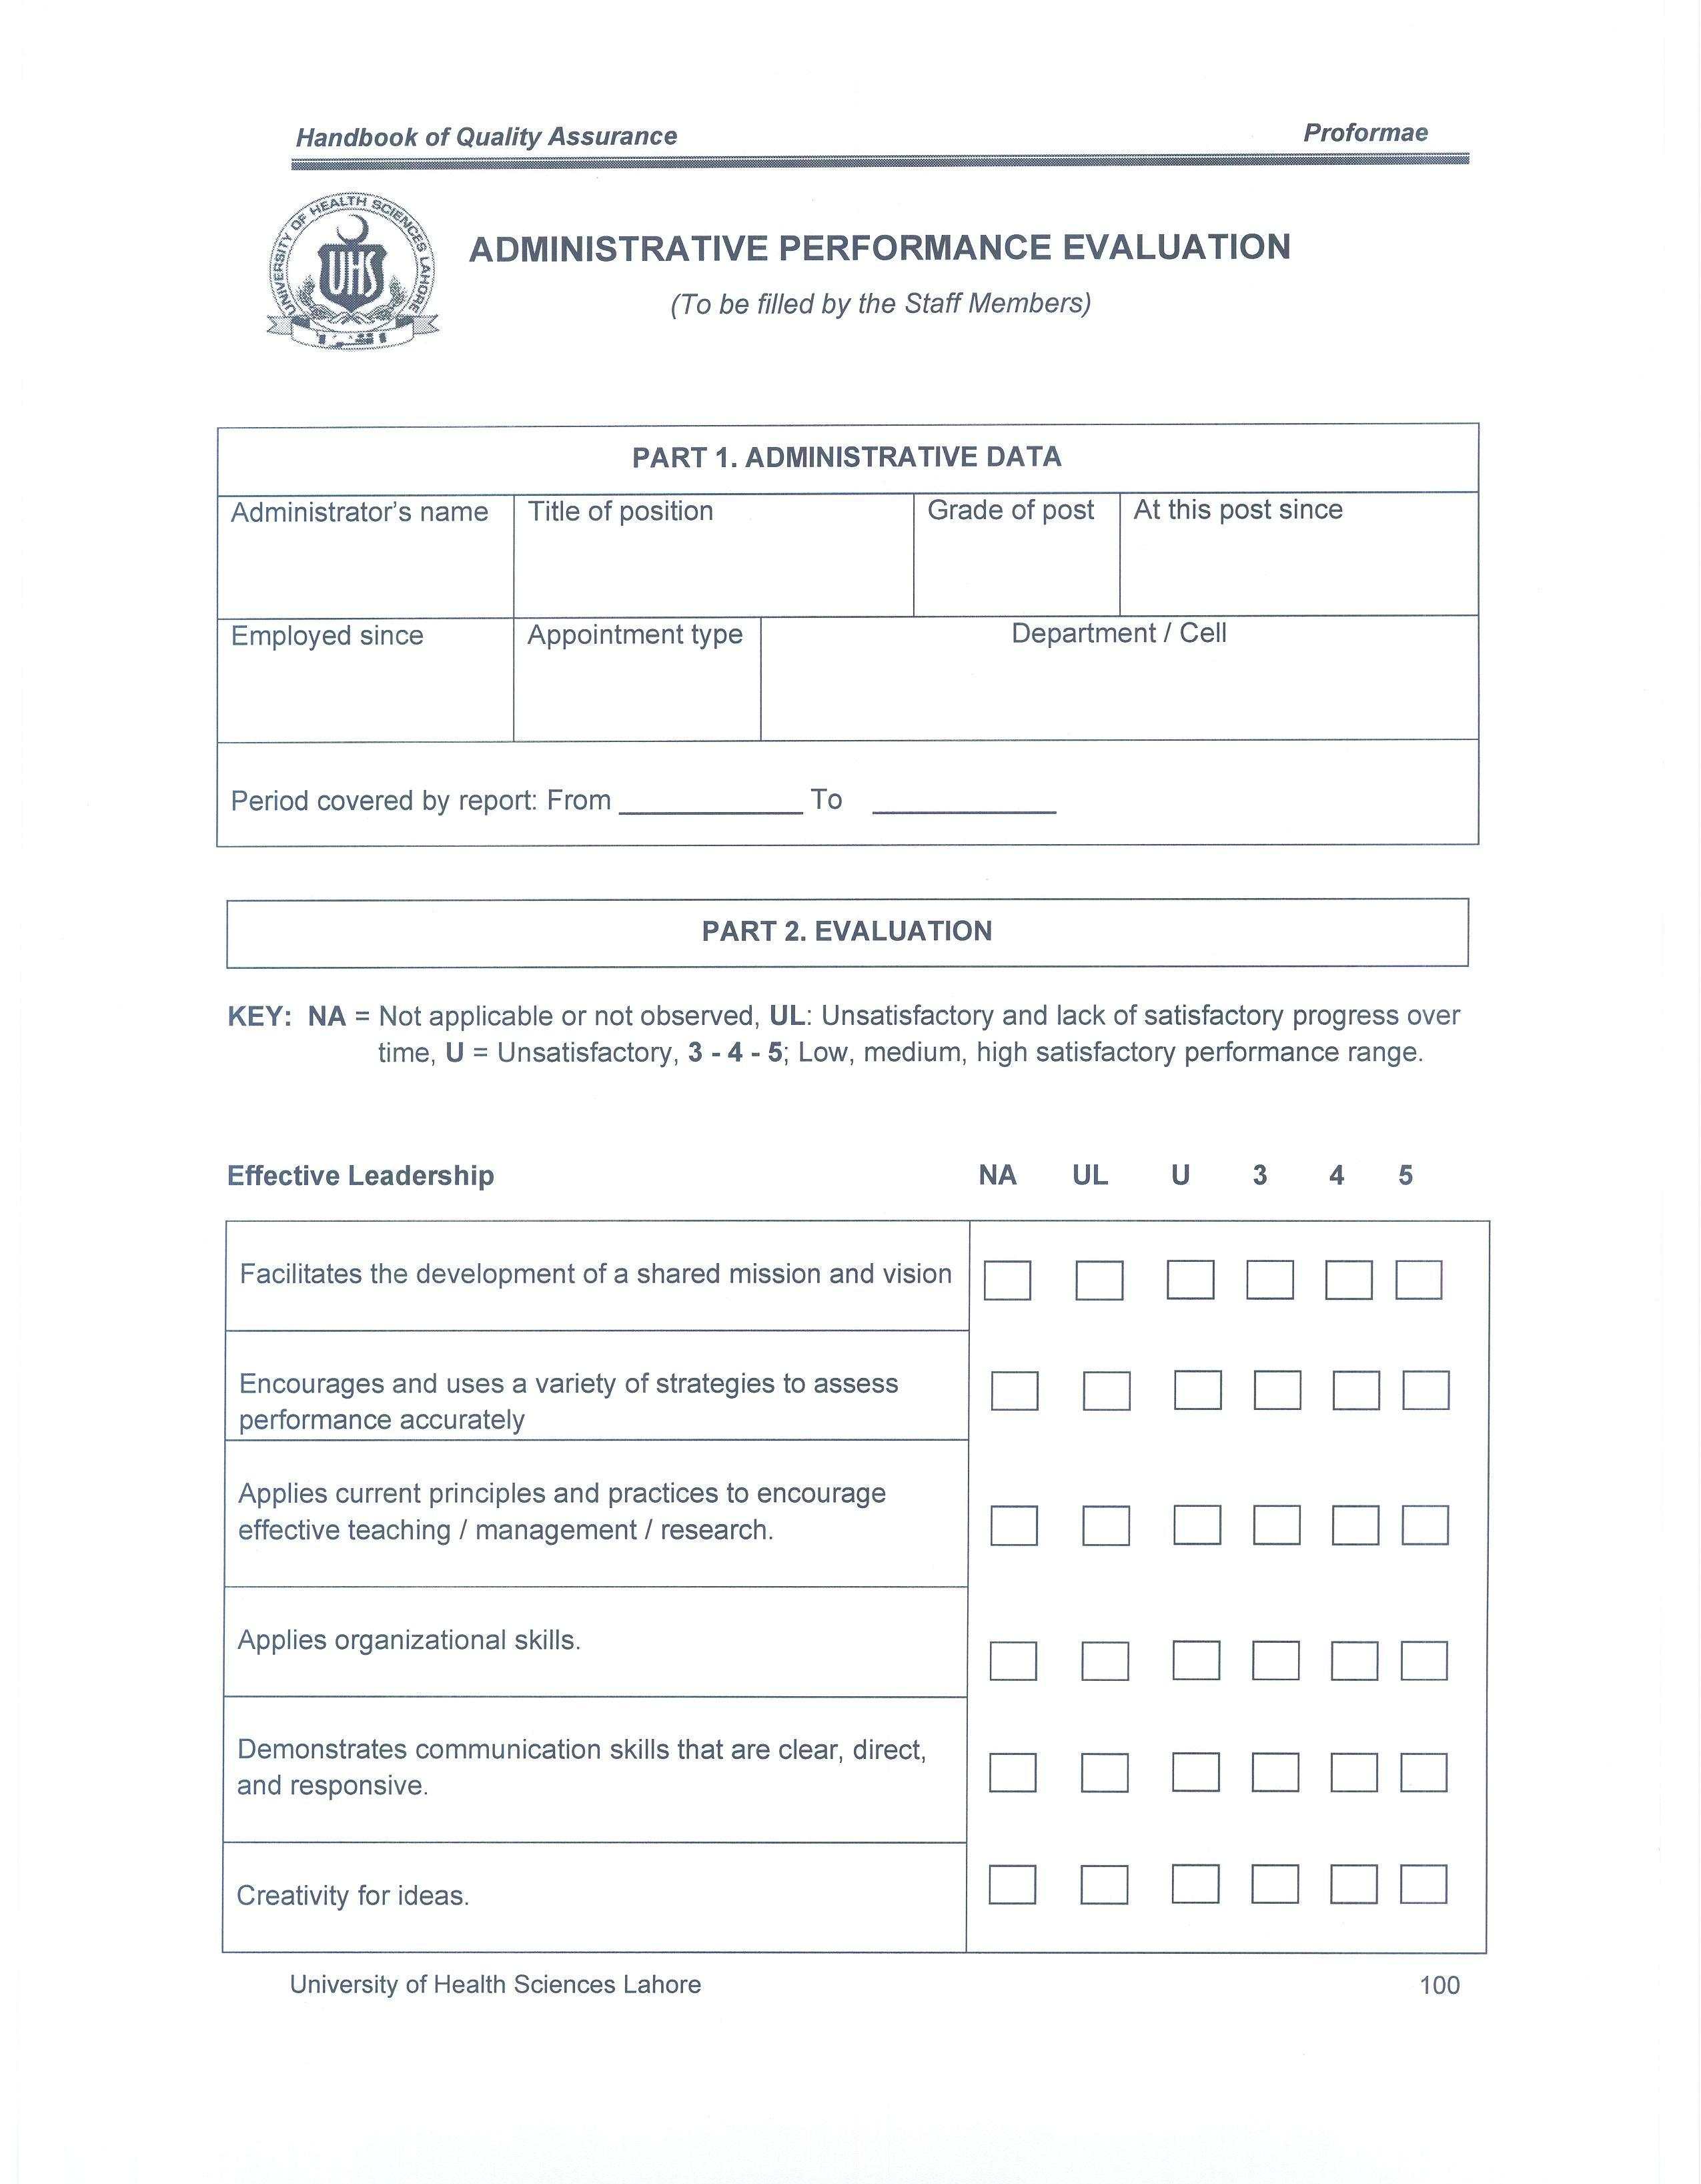
Administrative Performance Evaluation

Slide 22
Participation in all HEC events related to QECs (Meetings, Workshops, Seminars)
A representative of UHS has attended all the workshops conducted by HEC in QECs

Slide 23
Membership of QEC head in University Statutory Bodies
S.No. | Name of the statutory body | Date when acquired
Membership of International Bodies
S.No | Name of the International organization/ body | Date when acquired

Slide 24
QEC Webpage is in progress and all the proformas for quality assurance are being uploaded on UHS website.

Slide 25
Problems/Bottlenecks being faced by the QEC
Lack of Human Resources in this department

Slide 26
Submission of Quarterly Progress Report (July-Sept 2010) In process

Slide 27
Thank You!

