Slide 1


7TH Quarterly Meeting of
Quality Enhancement Cells (Phase-III)
UNIVERSITY OF HEALTH SCIENCES, LAHORE
Presented By: Prof. Dr. Arif Rashid Khawaja
FRCS (Ed), FRCS (Gen Surg)
Director, Quality Enhancement Cell
University of Health Sciences, Lahore

Slide 2
Agenda of 7th Meeting of Phase III QECs
Progress of QEC Activities pertaining to Self- Assessment process for the period July – December 2013
Additional task performed
Best practices in assessment process.

Slide 3
PROGRESS OF QEC ACTIVITIES PERTAINING TO SELF-ASSESSMENT PROCESS

Slide 4
PROGRESS OF QEC ACTIVITIES PERTAINING TO SELF-ASSESSMENT PROCESS
The SAR of 14 programs have been completed. 2 more programmes are under process.
Completed Proecess
M. Phil Forensic Medicine & Toxicology
Ph.D. Forensic Sciences
Master in Health Professional Education (MHPE)
T-DPT (Transitional Doctor of Physical Therapy)

Slide 5
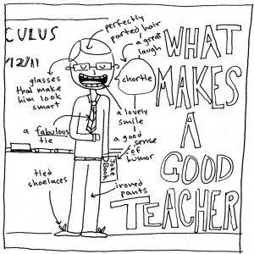
PROGRESS OF QEC ACTIVITIES PERTAINING TO SELF-ASSESSMENT PROCESS
The following two proformas have been distributed to all programs to determine the improvement of teacher performance and course of each program.
Course Evaluation Proforma
Teacher Evaluation Proforma

Slide 6

ADDITIONAL TASK PERFORMED BY QEC

Slide 7
ADDITIONAL TASK:
Awareness seminar on plagiarism.
HEI’s ranking data.
Teaching Research Methods and Biostatistics to M. Phil Students to enhance their research and analytical skills.
Centre for Innovation in Learning & Teaching is organizing a Certificate in Medical Teaching.

Slide 8
ADDITIONAL TASK:
Various International workshops on Medical Teaching & Learning have been arranged
Total Number of Workshops/activities = 16
Total number of Students = 390
Number of CMT Students
      Completed = 39
      In process = 30
Number of trained/certified facilitators = 07
Number of trained/certified mentors = 12
Number of students in “Introduction =29
to Medical Teaching

Slide 9
ADDITIONAL TASK:
Collaboration with University of Liverpool to start Masters in Health Professional Education (MHPE) in 2012. The 1st batch of 20 medical teachers would complete this program in 2014. The 2nd batch of an other 20 medical teachers has also been enrolled.
Facilitated 1st ever Ph. D in Medical Education in Pakistan. (Prof. Junaid Sarfraz Khan has been awarded a Ph. D that has been partly funded through INSPIRE grant).
Number of Research Projects = 07
Poster presentation at British Council Going Global March, 2013 in Dubai.
Oral presentation sent for Going Global 2014.

Slide 10
BEST PRACTICES IN ASSESSMENT PROCESS

Slide 11
BEST PRACTICES IN ASSESSMENT PROCESS:
The best practices in assessment process was a research study which was conducted by QEC department to determine the impact of evaluation of faculty by students and its impact on their performance.

Slide 12
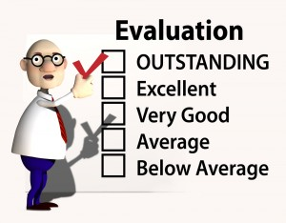
BEST PRACTICES IN ASSESSMENT PROCESS:
Objectives:
The primary objective is to determine the impact of evaluation of faculty by students on their performance and to increase the quality of course delivery.

Slide 13
BEST PRACTICES IN ASSESSMENT PROCESS:
Methods:
The study period was from January 2012 to January 2013.
All faculty members of UHS were evaluated by students on structured questionnaire by Higher Education Commission that have seven main components i.e., teaching techniques, effective planning, students/teacher relationship, lecture room environment, professionalism, course and research.

Slide 14
BEST PRACTICES IN ASSESSMENT PROCESS:
Results:
The mean scores of teaching techniques, effective planning, students/teacher relationship, lecture room environment, professionalism and research were significantly improve after the one year of evaluation whereas there was not significantly change in course mean score.

Slide 15
BEST PRACTICES IN ASSESSMENT PROCESS:
Key
0 | Poor
1 | Fair
2 | Good
3 | Excellent

Slide 16
BEST PRACTICES IN ASSESSMENT PROCESS:

Slide 17

BEST PRACTICES IN ASSESSMENT PROCESS:
Conclusion:
The Teacher Evaluation exercise by the students significantly improves the quality of teaching.
The QEC therefore can play a significant role in the overall improvement of the course contents as well as the teaching skills. But it requires dedicated staff and full support of the HODs and the VC. The QEC at UHS is lucky to have a team of staff members that believe in the important role the QEC can play in the overall quality assurance of the university.

Slide 18

Thank You

