Slide 1
University of Health Sciences, Lahore
Progress review of iQA mechanism
Presented by: Prof. Arif rashid khawaja
Date: 15th May, 2017

Slide 2
Current standing of QEC in the institution
The QEC is directly reporting to Head of the DAI
YES
Permanent and spacious premises is being allotted for QEC
YES
Notes:
In case an information is not getting fit in a given slide, you may give table of similar format, anywhere else in this file and insert hyperlink in the main slide.

Slide 3
Current standing of QEC in the institution
Number of Permanent/Full time QEC Officers/Officials
S.No. | Name | Designation | Date of Joining QEC
1 | Prof. Dr. Arif Rashid Khawaja | Director BPS-20 | 6-Dec-2010
2 | Dr. Allah Rakha | Deputy Director (Additional Charge) | 26-Dec-2012
3 | Waqas Latif | Data Analyst BPS-17 | 13-Jul-2011
4 | Noreen Aslam | Personal Assistant BPS-11 | 9-Jul-2011
Notes:
In case an information is not getting fit in a given slide, you may give table of similar format, anywhere else in this file and insert hyperlink in the main slide.

Slide 4
Current standing of QEC in the institution
Number of Statutory Bodies for which Head of QEC is a member including Plagiarism Standing Committee, Affiliation Committee etc.
S.No. | Name of Body/ Committee | Membership Status
1 | Senate/ Board of Trustees | -
2 | Syndicate/ Board of Governors/Executive Committee | √
3 | Academic Council | √
4 | Board of Advanced Studies & Research | √
5 | Selection Board | √
6 | Finance & Planning Committee | √
7 | Board of Faculty or Equivalent | -
8 | Board of Studies | √
9 | Affiliation Committee | √
10 | Discipline Committee | √
Notes:
In case an information is not getting fit in a given slide, you may give table of similar format, anywhere else in this file and insert hyperlink in the main slide.

Slide 5
Analysis of last year performance as per scorecard of 2015-16
Strengths (related to last year score card)
Regular workshops, conference attendance and participation in QAA activities actively
Weaknesses (related to last year scorecard)
Incomplete SAR of remaining programme
Incomplete online proforma
Permanent deputy director (Advertisement given, interview to be held soon)
Notes:
In case an information is not getting fit in a given slide, you may give table of similar format, anywhere else in this file and insert hyperlink in the main slide.

Slide 6
Analysis of last year performance as per scorecard of 2015-16
Notes:
In case an information is not getting fit in a given slide, you may give table of similar format, anywhere else in this file and insert hyperlink in the main slide.

Slide 7
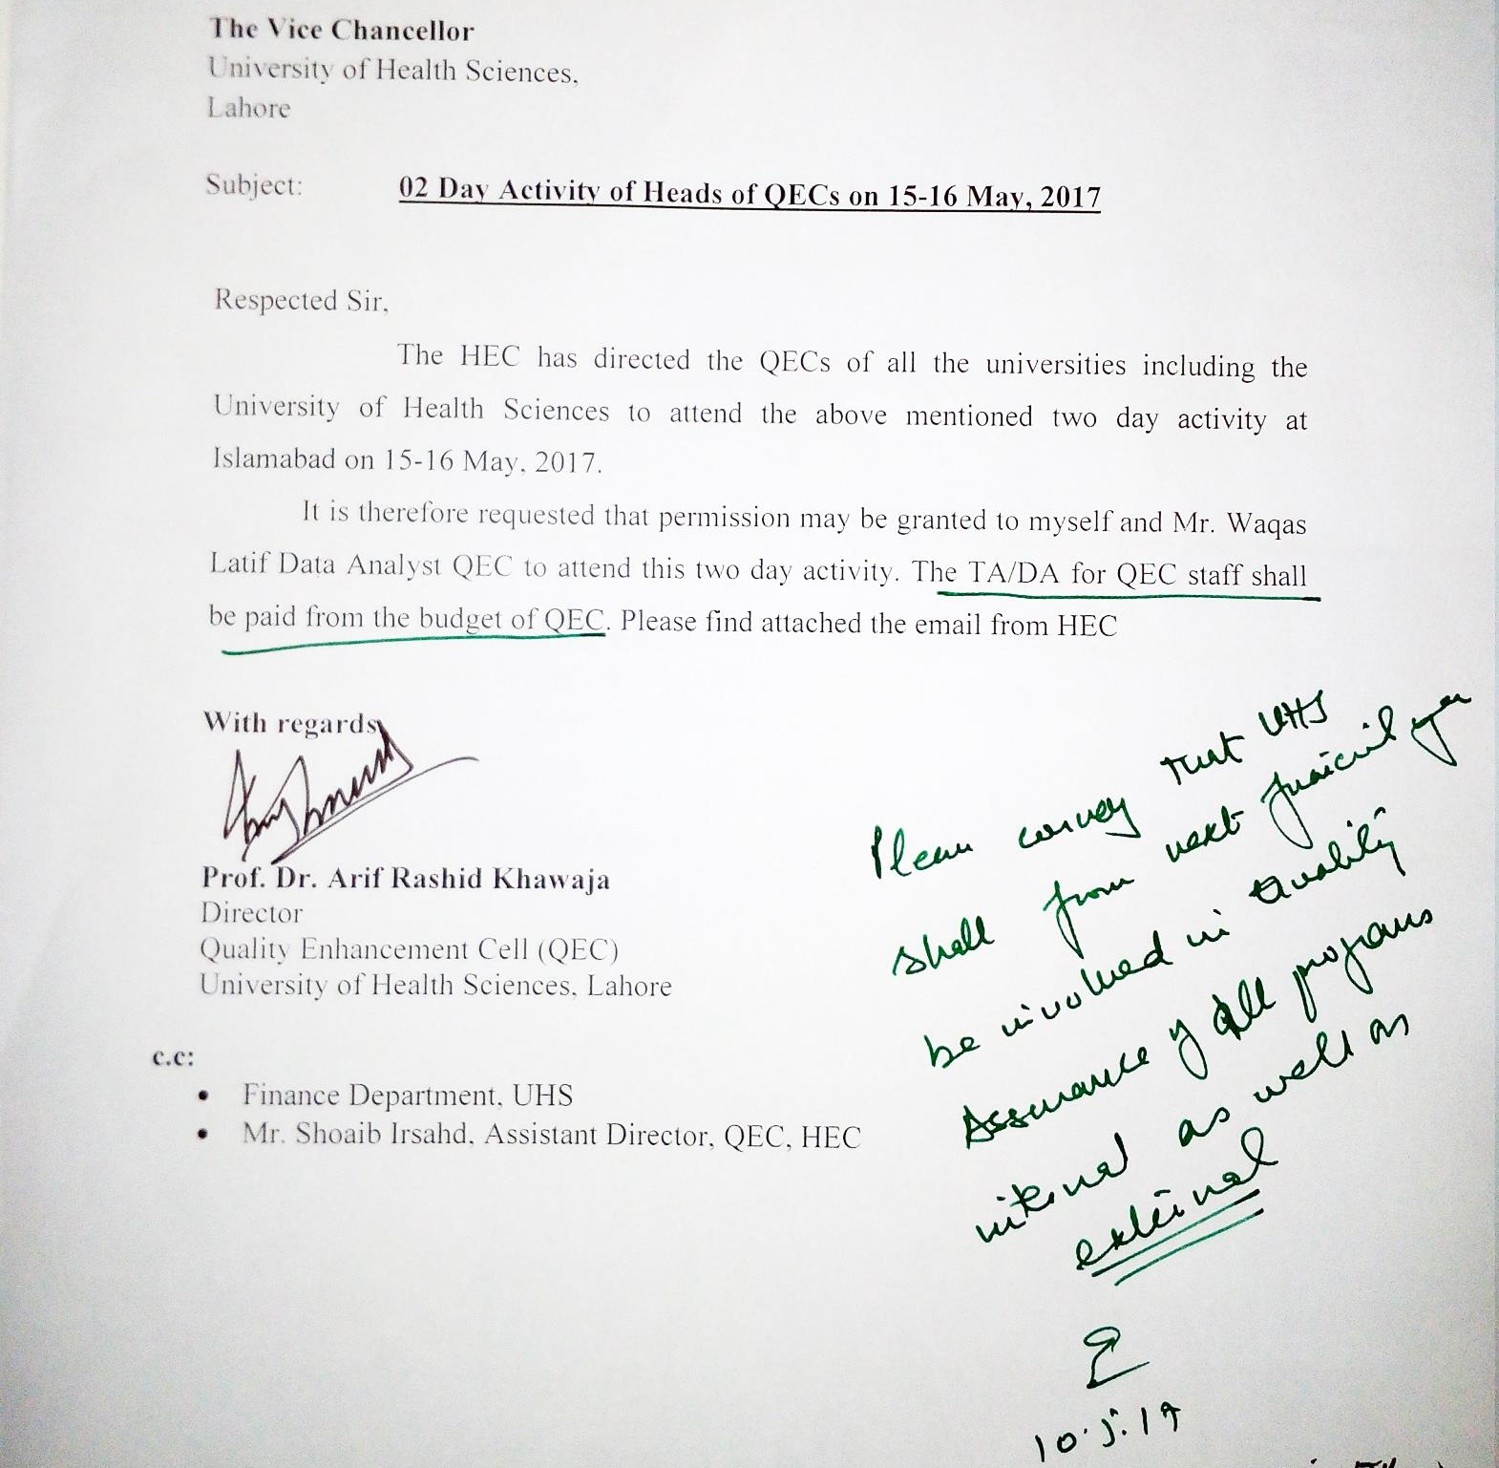
Notes:
In case an information is not getting fit in a given slide, you may give table of similar format, anywhere else in this file and insert hyperlink in the main slide.

Slide 8
Weak Areas Identified (related to functionality of QEC)
Lack of influence in affiliated institutions.
No financial autonomy in executing the functions of QEC.
The budget is approved by BOG and can reduce the budget.
There seems to be lack of guidance on certain issues from QAA.
(Recent communication)
Notes:
In case an information is not getting fit in a given slide, you may give table of similar format, anywhere else in this file and insert hyperlink in the main slide.

Slide 9
Implementation Plan and Actions Taken to address Weak Areas identified in previous slide
Implementation Status
To be discussed in the current forum
Action Plan
Accordingly
Notes:
In case an information is not getting fit in a given slide, you may give table of similar format, anywhere else in this file and insert hyperlink in the main slide.

Slide 10
Hindrances in achieving the targets
Financial constraints in implement QAA in affiliated institutions.
Lack of interest in Quality Assurance in the faculty if these institution.
Lack of staff to perform the massive task of QA implementation.
Unrealistic time frame.
Notes:
In case an information is not getting fit in a given slide, you may give table of similar format, anywhere else in this file and insert hyperlink in the main slide.

Slide 11
Help Required from HEC
Clear guideline to HEI regarding the status of QEC including Director QEC.
Clear guideline about the budget for QEC in the recurring grant.
Implementation of job progression with in the staff of QEC with regards to promotion and increments. (Lack of job structure).
All QEC heads having ‘W’ Ranking status to be given BPS-21 and this condition should be included in the ranking of the university.
Notes:
In case an information is not getting fit in a given slide, you may give table of similar format, anywhere else in this file and insert hyperlink in the main slide.

Slide 12
Questions / Answer Session

